Slide 1
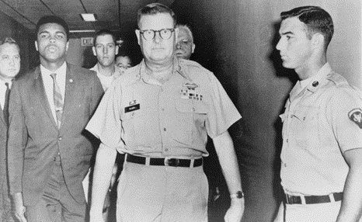
U.S. v. Clay
Courtesy: Library of Congress
Federal Trials and Great Debates
in United States History

Slide 2
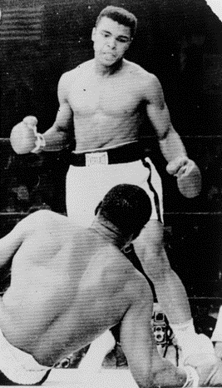
The Conversion of Cassius Clay
Cassius Clay, Jr. became heavyweight champion of the world in 1964.
Shortly after winning the title, he announced he had joined the Nation of Islam.
He changed his name to Cassius X and then to Muhammad Ali.
Ali in the ring, 1965
Courtesy: Library of Congress

Slide 3
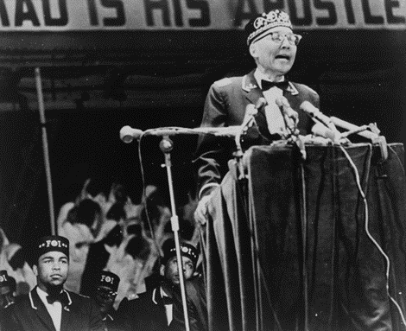
The Nation of Islam
Ali’s conversion was very controversial.
The Nation of Islam emphasized the plight of African Americans as well as more traditional Islamic beliefs.
Many critics claimed the group was racist and wanted to create a separate society for African Americans.
Ali watches as Nation of Islam leader Elijah Muhammad speaks to followers
Courtesy: Library of Congress

Slide 4
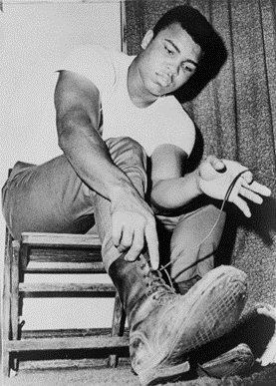
Ali and the Draft
During the Vietnam War, hundreds of thousands of young men were conscripted, or “drafted,” into the armed forces.
Federal law imposed a maximum sentence of five years in prison and a $10,000 fine on eligible men who refused to serve.
Ali tries army boots on for size
Courtesy: Library of Congress

Slide 5
Ali and the Draft
When he became eligible for the draft in 1966, Ali announced that he had “no quarrel with them Vietcong.”
He felt America should fix racism and oppression at home instead of fighting in Vietnam.
At that time the war was popular with the public and few other celebrities dared to object.
Ali was widely criticized.
Ali tries army boots on for size
Courtesy: Library of Congress

Slide 6
Conscientious Objection
Ali claimed that he should be exempted from military service as a “conscientious objector.”
This status protected some individuals from service based on their beliefs.
Contentious objectors had to show three things:
That they objected to all wars;
That their objections were based on religion; and
That their objections were sincere

Slide 7
The Selective Service Process
Conscientious objector claims were handled by an agency called the Selective Service System (“SSS”).
Lawyers for the Department of Justice advised the SSS that Ali failed all three of the criteria for objector status.
The SSS rejected Ali’s claims, and he was ordered to report for military service.
Armed Forces Examining and Entrance Station, Houston, Texas

Slide 8
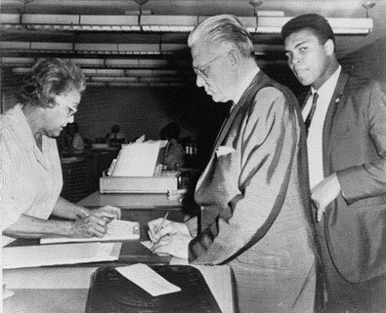
The Trial
Ali refused to enter the military.
He was immediately stripped of his titles and barred from fighting.
He was tried in federal court in Houston.
The jury convicted him after deliberating for only 20 minutes.
Judge Joe Ingraham sentenced Ali to the maximum penalty of 5 years in prison and a $10,000 fine.
The Court of Appeals for the Fifth Circuit denied Ali’s appeals.
Ali with trial attorney Hayden Covington
Courtesy: Library of Congress

Slide 9
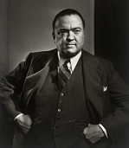
Covert Surveillance
During Ali’s appeal, government lawyers disclosed that his was one of several cases that might have been affected by illegal F.B.I. wiretaps.
The Supreme Court sent the case back to the trial court for a hearing to determine whether illegal surveillance had improperly influenced Ali’s trial.
Judge Ingraham ruled against Ali because the information exchanged in the calls was “innocuous.”
The Court of Appeals for the Fifth Circuit again affirmed Judge Ingraham’s decision.
Under J. Edgar Hoover (1935-1972), the F.B.I. surveiled many public figures
Courtesy: Smithsonian Institute
Diagram of the appeals process

Slide 10
The Appeals Process
Supreme
Court
of the U.S.
U.S. Court of Appeals for the Fifth Circuit
U.S. District Court
for the Eastern District of Texas
(trial court)
Initial Appeal
Second Appeal
Remand
Initial Appeal
SecondAppeal

Slide 11
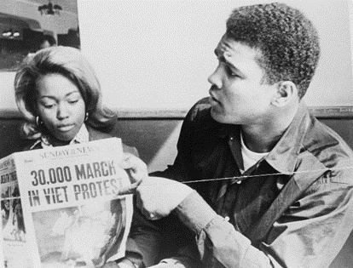
Changing Attitudes
Ali’s appeal process lasted from 1967 to 1971.
During that time, the nation’s attitudes towards Vietnam, the draft, and Ali himself began to shift.
More than 58,000 American soldiers were killed in Vietnam.
As the war dragged on, many Americans began to question whether the war was worth fighting.
The draft process also became increasingly unpopular.
Ali was an early critic of the Vietnam War
Courtesy: Library of Congress

Slide 12
Changing Attitudes
As it became clear Ali was willing to make great sacrifices, many started to respect his sincerity and tenacity.
Martin Luther King, Jr., captured a growing sentiment when he argued that “no matter what you think of Mr. Muhammad Ali’s religion, you certainly have to admire his courage.”
Ali was an early critic of the Vietnam War
Courtesy: Library of Congress

Slide 13
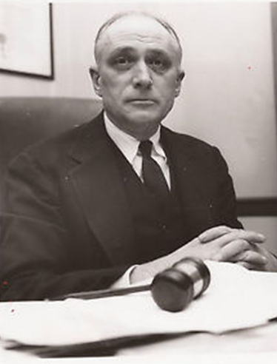
Clay v. United States (1971)
When Ali took his case to the Supreme Court for a second time, the Justices limited the appeal to whether the DOJ had given erroneous legal advice to the SSS.
Solicitor General Erwin Griswold admitted that Ali had sincere religious beliefs, but argued Ali only objected to fighting in “the white man’s wars[.]”
Justice John Marshall Harlan II
Courtesy: Library of Congress

Slide 14
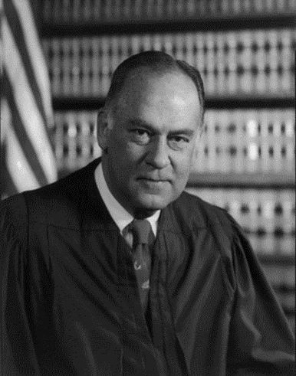
Clay v. United States (1971)
When the justices initially voted on the case, a 5-3 majority supported affirming Ali’s conviction.
Justice John Marshall Harlan II changed his mind after researching the Nation more fully. This left the case tied 4-4.
Justice Potter Stewart then persuaded the remaining justices that the SSS might have denied Ali’s objection to the war based on the incorrect assumptions that he was insincere and that his views were not based on religion.
Stewart wrote a per curium (a brief opinion on behalf of several justices) overturning Ali’s conviction.
Justice John Marshall Harlan II
Courtesy: Library of Congress
Justice Potter Stewart
Courtesy: Library of Congress

Slide 15
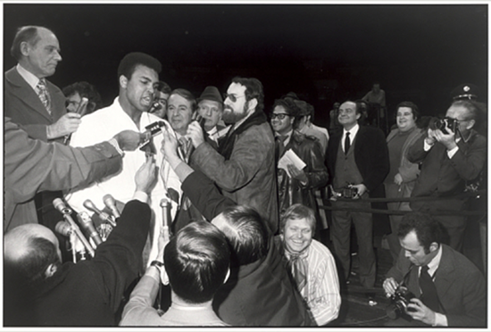
The Aftermath
Ali was permitted to fight again shortly before the Supreme Court’s decision.
He eventually regained his world title and became widely regarded as one of the greatest athletes of the twentieth century.
Though Ali’s opposition to the draft was once very unpopular, he became a much-loved figure.
Ali’s draft case formed an important part of his persona.
Ali eventually regained his title and popularity
Courtesy: Smithsonian Institute

Slide 16
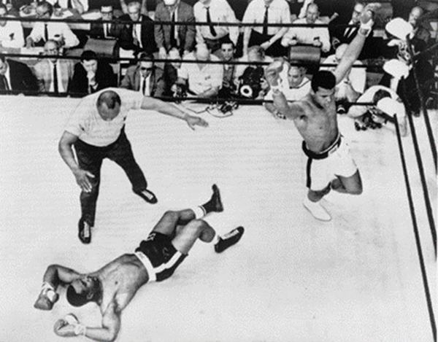
Legal Issues and Social Debates
U.S. v. Clay has long been heralded as a landmark for religious liberty.
The idea of a black Muslim beating the U.S. government in court inspired many people around the world.
Several popular books and films about Ali have reinforced this narrative of the case.
Ali’s fame and athletic skill may account for the later perception of the case
Courtesy: Library of Congress

Slide 17
Legal Issues and Social Debates
However, the courts mostly focused on a different set of issues.
Even the Supreme Court decision in Ali’s favor did not hold that Ali was a conscientious objector.
Instead, the Courts were primarily concerned with the fairness of the process by which Ali was convicted.
Ali’s fame and athletic skill may account for the later perception of the case
Courtesy: Library of Congress

