Slide 1
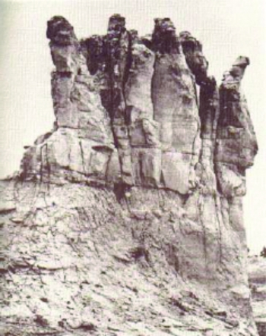
The Teapot Dome Scandal
Federal Trials and Great Debates in United States History

Slide 2
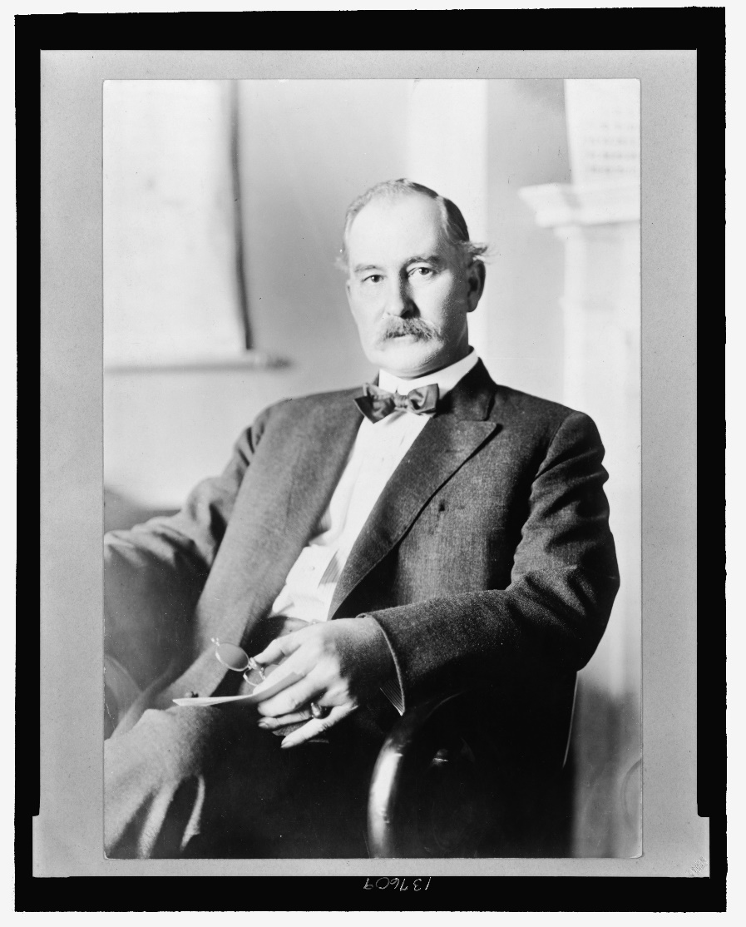
Introduction
Teapot Dome was one of the biggest government corruption scandals in U.S. history.
Secretary of the Interior Albert B. Fall accepted money from two oil magnates in exchange for allowing their companies to drill in oil reserves set aside for the U.S. Navy.
Fall was the first cabinet official to go to prison.
The scandal was characteristic of rampant corruption in the Warren Harding administration.
Albert B. Fall

Slide 3
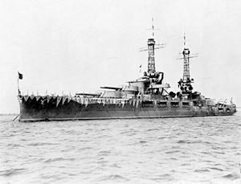
Naval Oil Reserves
In the early 20th century, the U.S. Navy switched from coal to oil as its main fuel source.
In 1912 and 1915, Presidents William Taft and Woodrow Wilson designated oil lands in CA and WY as reserves for the Navy’s use.
The CA reserves were known as Elk Hills and Buena Vista. The WY reserve was called Teapot Dome.
A 1920 statute empowered the Secretary of the Navy to make decisions about the reserves.
USS Oklahoma (1916)

Slide 4
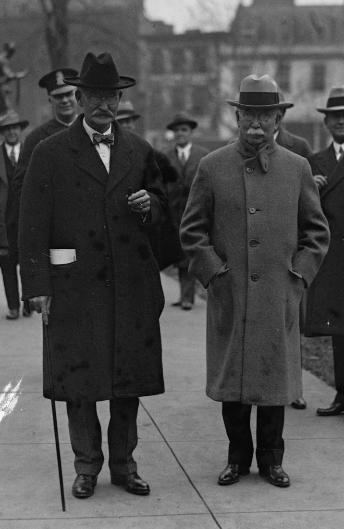
Albert Fall (1861-1944)
Worked in prospecting, mining, ranching, and land speculation in Mexico and the U.S. Southwest
Republican U.S. senator from NM, 1912-1921
Anti-conservation voting record; was in favor of using natural resources aggressively
Served as Interior secretary, 1921-1923
Got President Harding to transfer management of naval oil reserves to Interior Department
Fall (L) with Edward Doheny

Slide 5
The Elk Hills Lease
In November 1921, Edward L. Doheny of Pan-American Petroleum and Transport Co. loaned Fall $100,000 in cash.
In April 1922, Doheny signed a contract to build an oil storage depot at Pearl Harbor to be paid for with the government’s “royalty oil.”
The contract contained a “preference right” to drill in the Elk Hills naval reserve if the government decided to lease it.
In December 1922, Doheny gained the right to drill in the entire eastern half of the reserve.
Doheny expected to make $100,000,000 from the deal.

Slide 6
The Teapot Dome Lease
In April 1922, Fall granted Harry Sinclair of Sinclair Oil Co. a lease to drill in the entire Teapot Dome naval oil reserve.
A short time later, Sinclair gave Fall $233,000 in Liberty Bonds and $36,000 in cash.
Sinclair had acquired the Liberty Bonds through a money laundering operation known as the Continental Trading Co.
Like the Elk Hills deal, the Teapot Dome lease had the potential to be extremely lucrative.

Slide 7
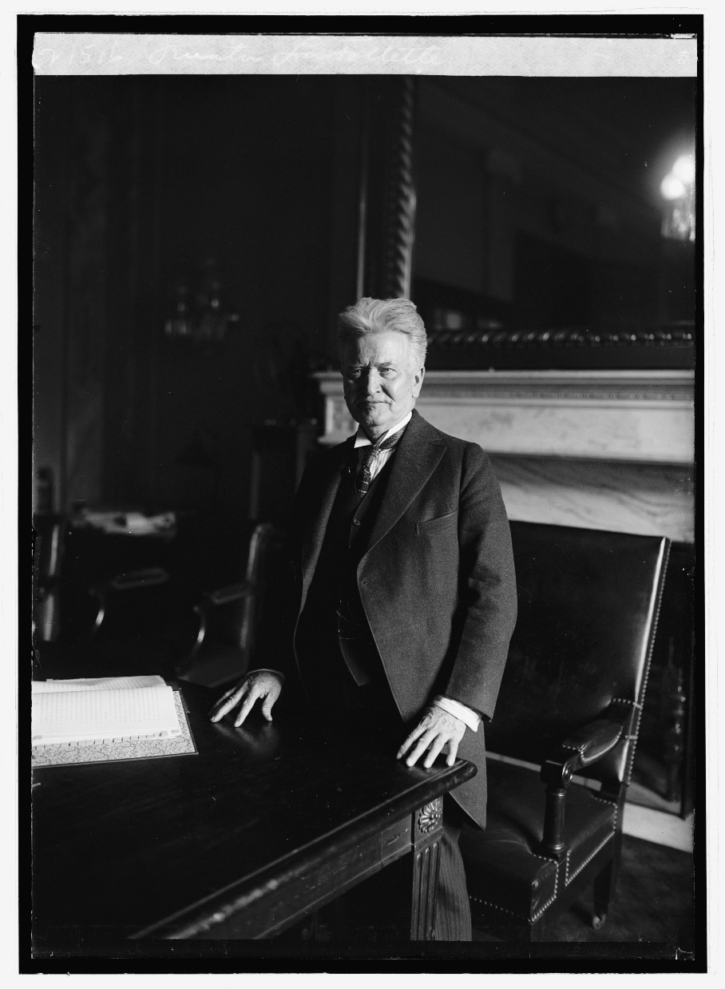
Senate Reaction
U.S. senators were stunned and upset to learn that the naval reserves had been leased to private interests.
They were also disturbed that:
The transactions had taken place in secret.
Other oil companies had not been allowed to bid on the contracts.
Leasing the reserves could deprive the Navy of sufficient oil.
Senator Robert M. La Follette

Slide 8
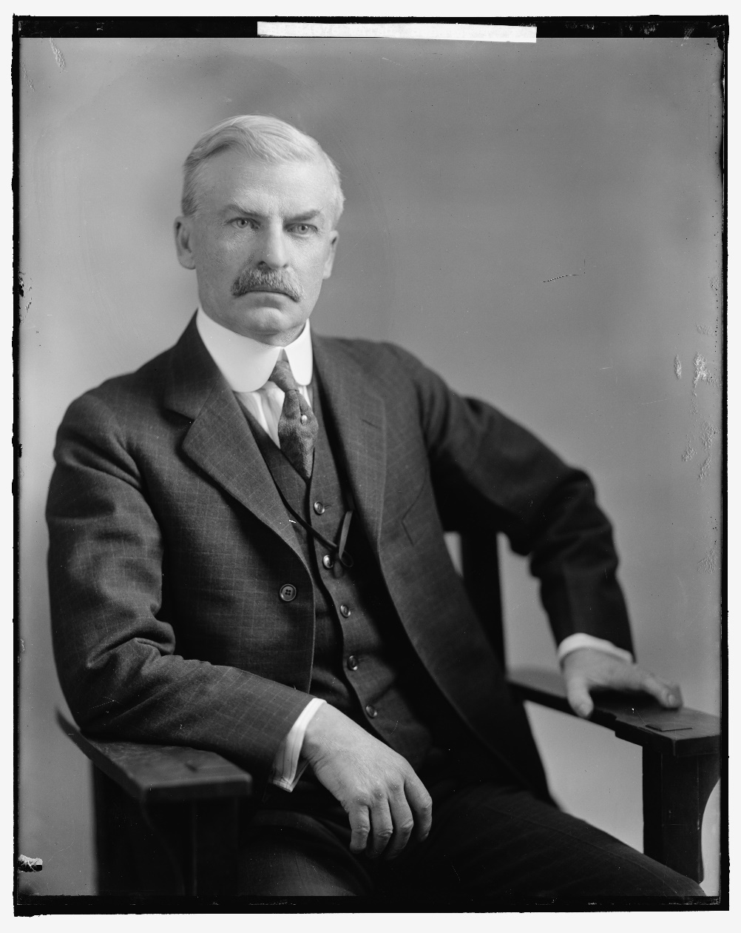
Senate Investigation
The Public Lands and Surveys Committee held hearings in 1923-1924.
Testimony revealed that Fall’s financial circumstances had improved greatly in 1922.
Fall lied about where he got the money, and wrote the committee that he had never received any money from Sinclair or Doheny.
The Committee eventually discovered he had received money from both men.
These revelations turned Teapot Dome into a full-blown national scandal.
Senator Thomas J. Walsh

Slide 9
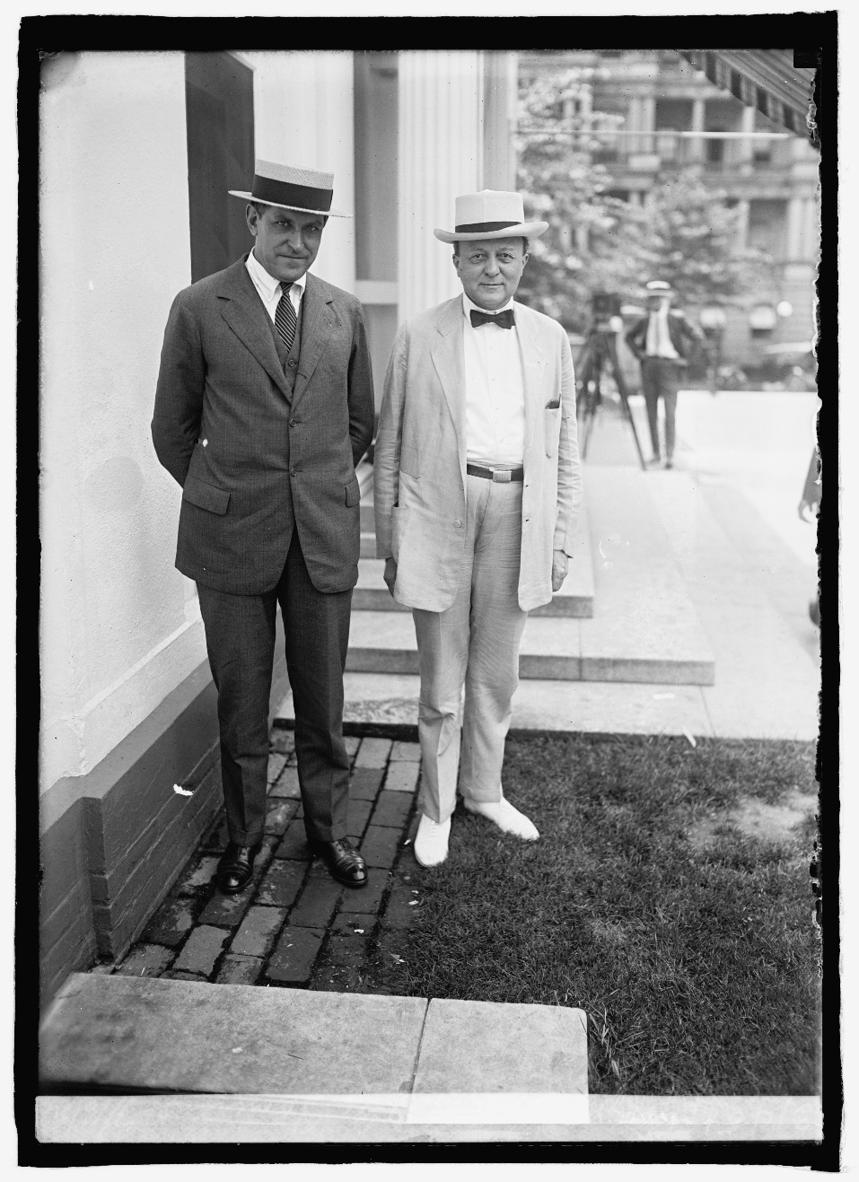
Civil Lawsuits
Calvin Coolidge appointed Owen Roberts and Atlee Pomerene as special counsels for Teapot Dome.
They filed lawsuits in federal courts in CA and WY seeking to have the leases rescinded for fraud.
In 1925, the government won at trial in CA but lost in WY.
Both cases ended up in the Supreme Court, which canceled both leases and called Fall a “faithless public officer.”
Owen Roberts & Atlee Pomerene

Slide 10
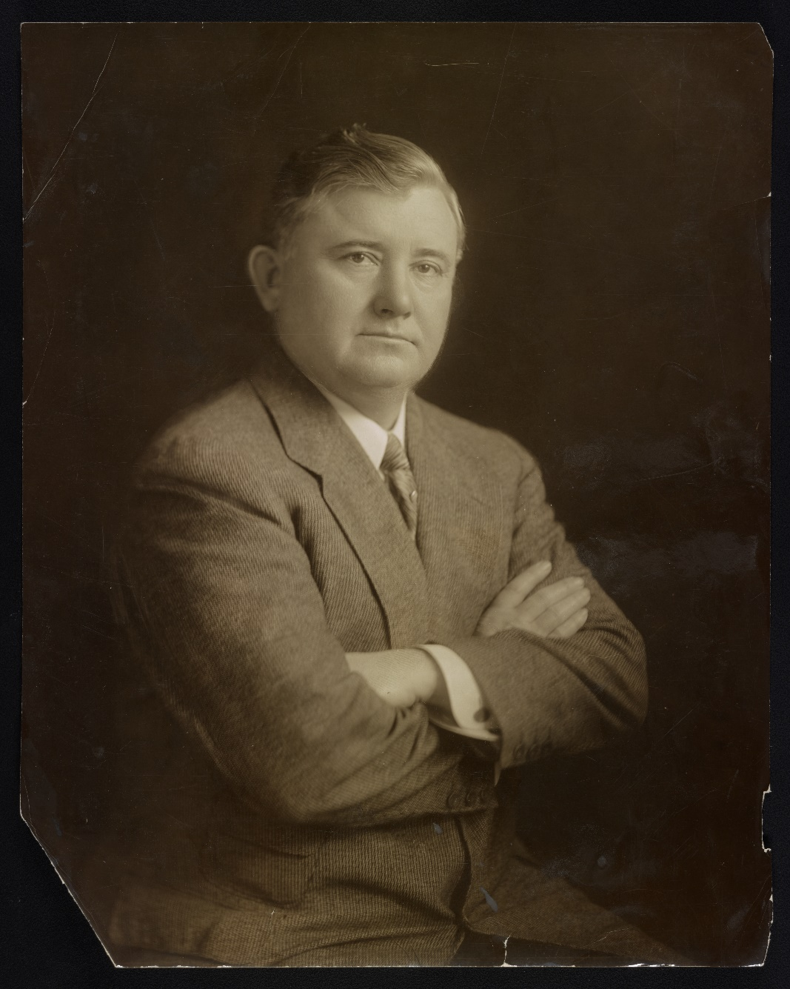
Defense Arguments
The defense attorneys for the two oil companies argued unsuccessfully that:
Teapot Dome was being threatened by drainage from an adjoining oil field.
The Pearl Harbor deal was necessary to national security because of the threat of invasion.
Navy Secretary Denby, not Fall, was the driving force behind the deals.
Doheny’s loan to Fall was a private transaction between old friends and had no influence.
Sinclair attorney Martin Littleton

Slide 11
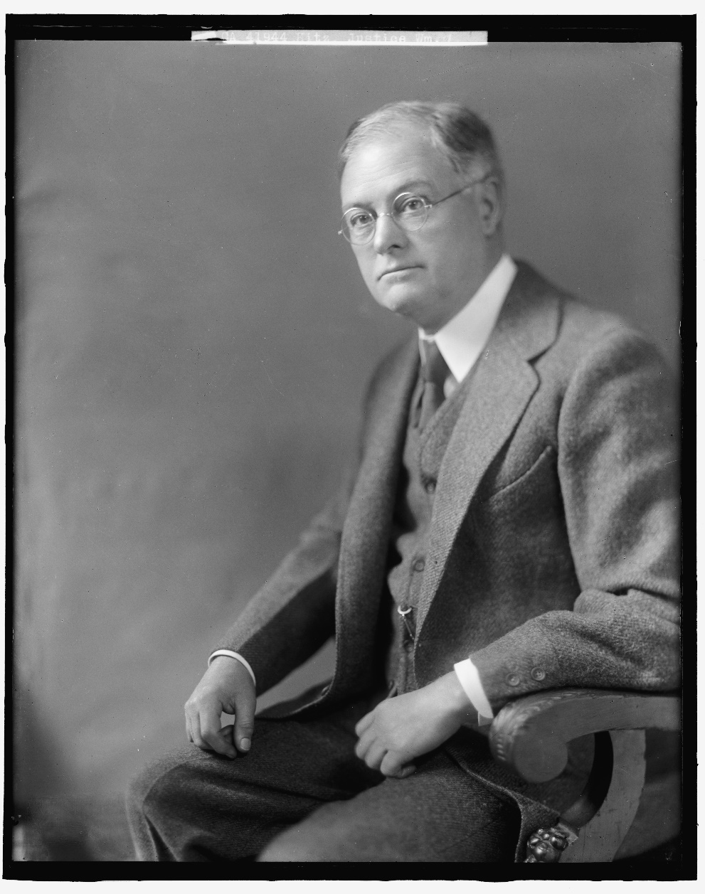
Criminal Trials
Criminal indictments in the District of Columbia charged conspiracies to defraud the U.S. government between Fall and Doheny and between Fall and Sinclair.
Additionally, Fall and Doheny were charged with bribery (evidence of Sinclair’s bribery had not fully come to light).
The arguments and evidence in the criminal trials were similar to those in the civil suits.
The cases were tried in the Supreme Court of the District of Columbia between 1926 and 1930.
Justice William Hitz

Slide 12
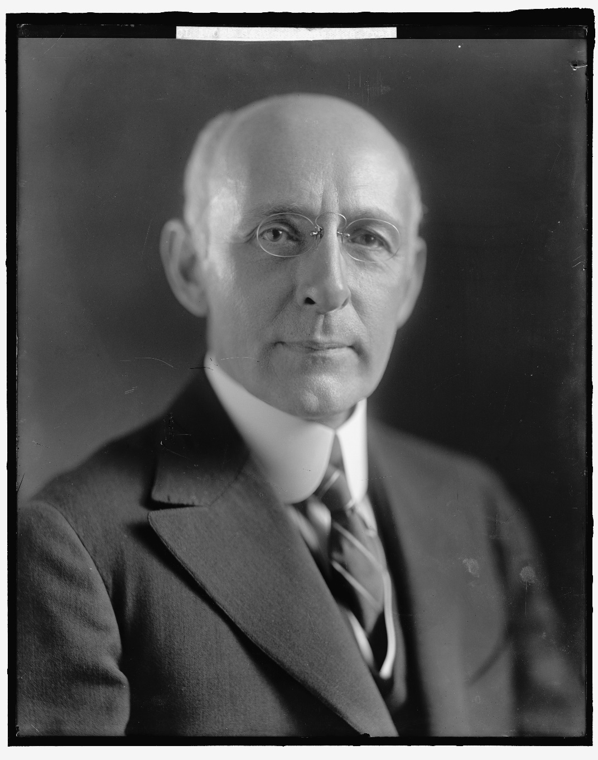
Criminal Trials
1926: Fall and Doheny acquitted of conspiracy
1927: Mistrial interrupts Fall/Sinclair conspiracy trial
1928: Sinclair acquitted of conspiracy (Fall not retried due to health problems)
1929: Fall convicted of receiving a bribe; sentenced to 1 year in prison and $100K fine; Court of Appeals of D.C. affirmed
1930: Doheny acquitted of paying a bribe
Justice Frederick L. Siddons

Slide 13
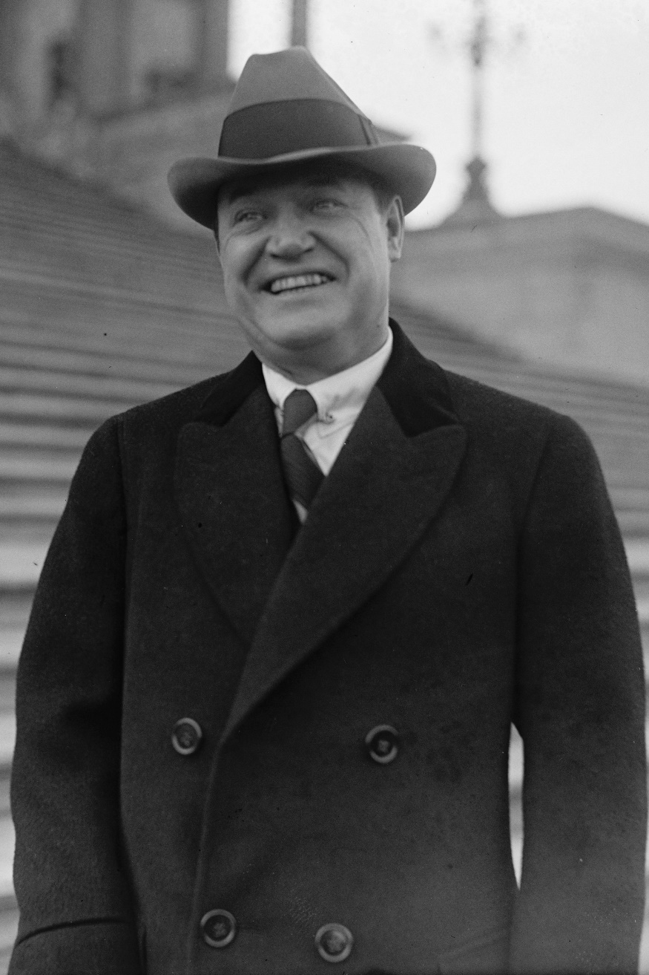
Sinclair Contempt Trials
After testifying once, Harry Sinclair was recalled to appear before the Senate committee, but refused to answer more questions.
He was convicted of contempt of the Senate in 1927.
Sinclair also had jurors surveilled by detectives during his first conspiracy trial.
He was convicted of contempt of court in 1928.
The Supreme Court affirmed both convictions.
Sinclair served about six months in prison.
Harry F. Sinclair

Slide 14
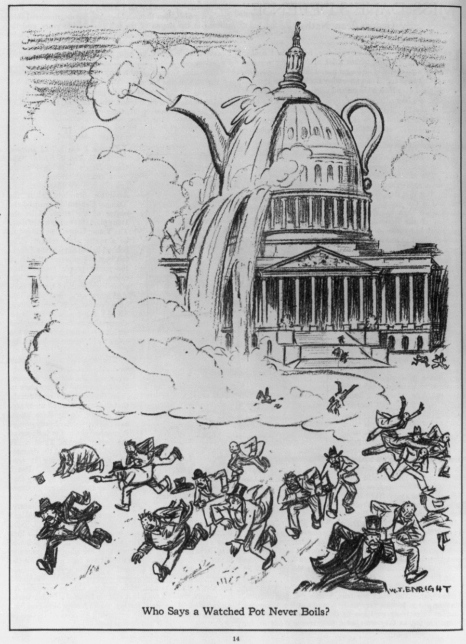
Reactions
Teapot Dome was a prominent national news story, and from January 1924 on, was treated as a major scandal.
Newspapers overwhelmingly approved of the cancelation of the leases.
Editorial writers and members of Congress expressed frustration at the lack of criminal convictions. Some alleged that the wealthy and powerful could not be held accountable for their misdeeds.
Fall’s conviction brought some measure of satisfaction, although many felt pity because of his poor health and destroyed reputation.

Slide 15
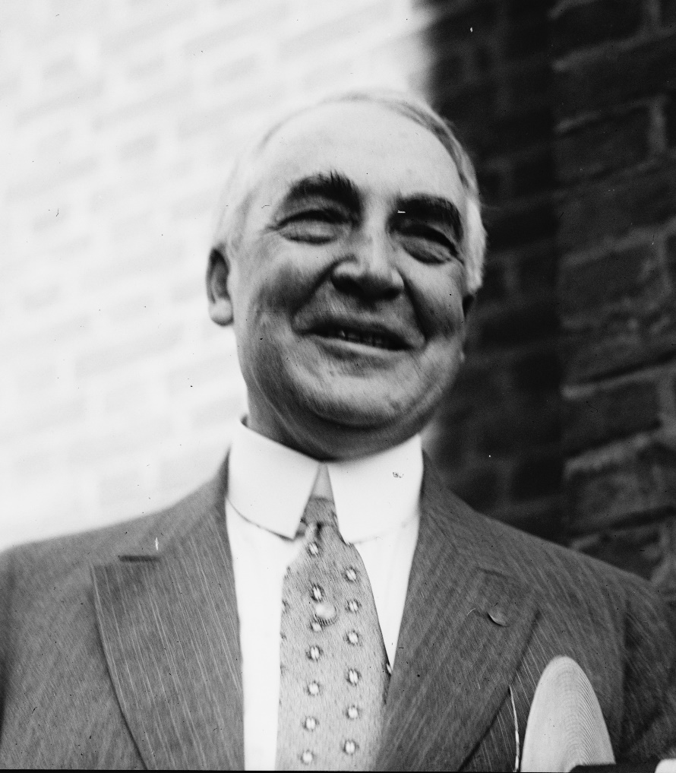
Legacy and Aftermath
The Teapot Dome scandal weakened public faith in government.
It became a defining feature of Warren Harding’s brief presidential administration.
However, the scandal did not lead to a reevaluation of the close relationships between business titans and government officials.
The episode did result in some legislative reforms, but these were minor and had no significant effects.
President Warren G. Harding

Slide 16
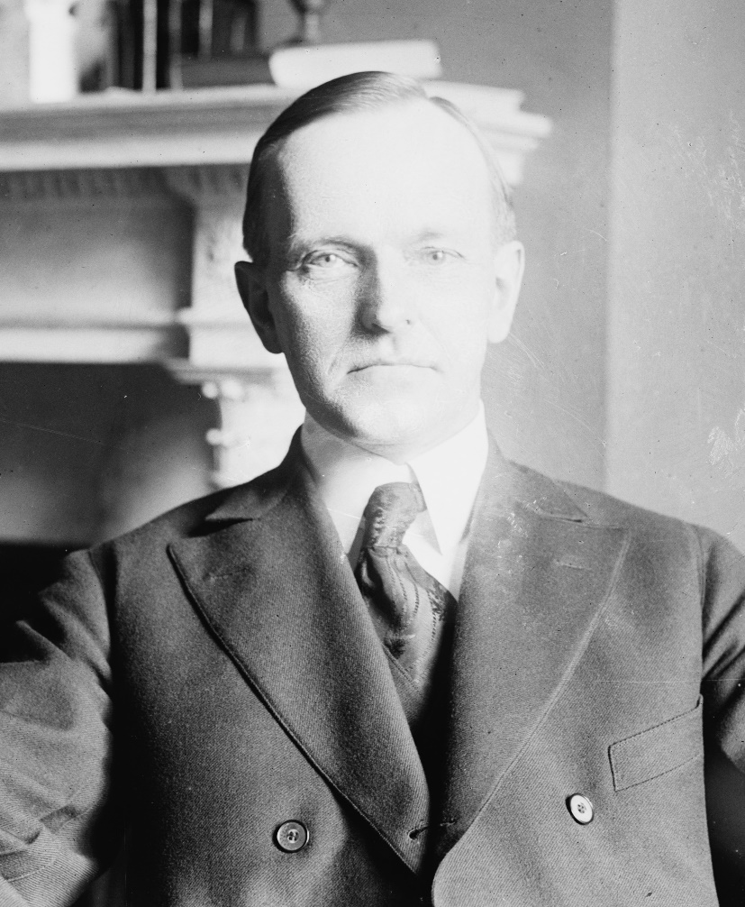
Legacy and Aftermath
Although Teapot Dome is often thought of as a political scandal, it did not have substantial political effects.
Calvin Coolidge paid no price for the scandal, winning the 1924 election in a landslide.
Democrats tried once again to make corruption an issue in the 1928 election, with no success.
The federal courts played a crucial and underappreciated role in the resolution of Teapot Dome.
President Calvin Coolidge

