Slide 1
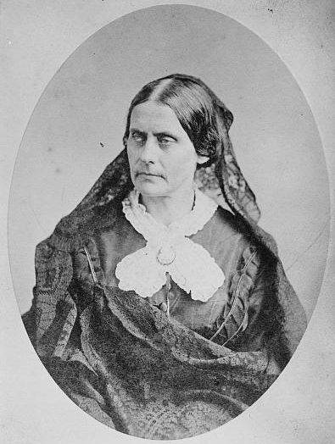
The Trial of Susan B. Anthony
Courtesy: Library of Congress
Federal Trials and Great Debates
in United States History

Slide 2
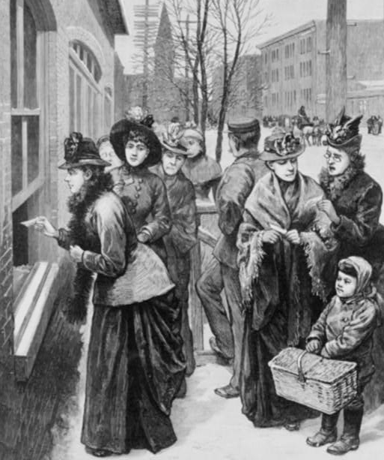
A Brief History of Suffrage
Most Americans were denied voting rights for most of the nation’s history.
The 1787 U.S. Constitution did not provide citizens with a right to vote.
Instead, states dictated who could vote.
At the time the Constitution was ratified, most states restricted the vote to white, property-owning men.
Over the course of the nineteenth century, states expanded and contracted the voting rights of other groups.
Illustration of women voting in Wyoming (1888)
Courtesy: Library of Congress

Slide 3
A Brief History of Suffrage
The Fourteenth Amendment (1868) granted citizenship to persons born in the U.S.
It prohibited states from denying citizens the “privileges or immunities” of citizenship.
It also prohibited states from denying “equal protection” of the law to people within their jurisdiction.
The Fifteenth Amendment (1870), prohibited states from denying citizens their “right to vote” on the basis of race.
Advocates for women’s suffrage argued these amendments meant women were citizens of the United States and thus entitled to vote.
Illustration of women voting in Wyoming (1888)
Courtesy: Library of Congress

Slide 4
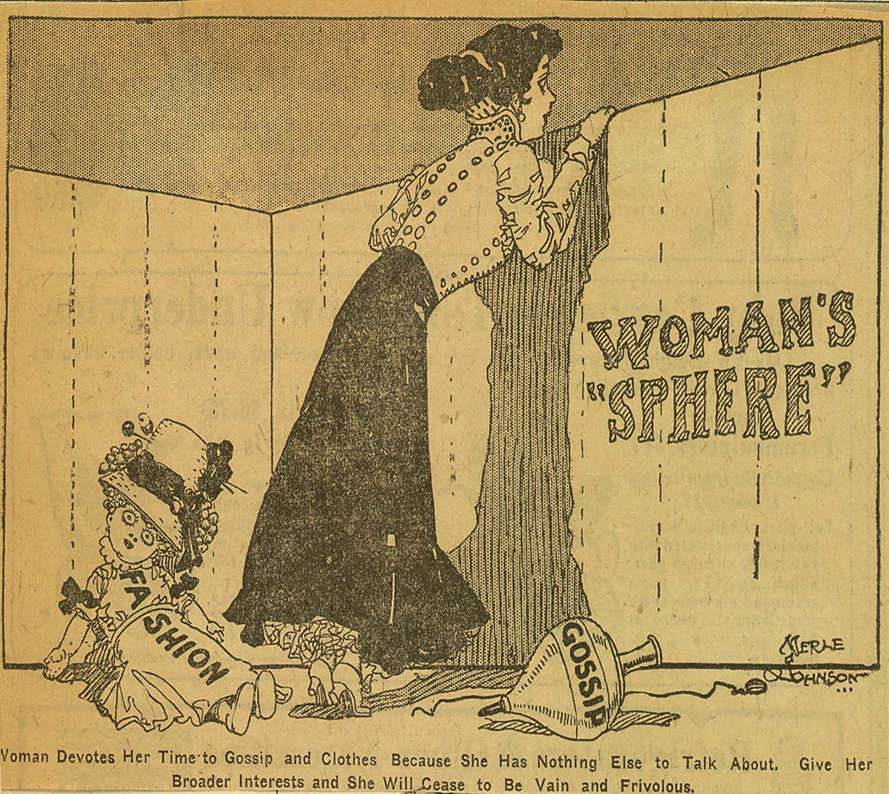
The “Separate Spheres”
Voting was just one area of gender inequality in 19th century America.
American law supported “separate spheres” for men and women.
Men dominated the public sphere of business and politics.
Women ran the “domestic” sphere of raising families and keeping a home.
Cartoon critiquing the “woman’s sphere” (circa 1909)
Courtesy: Library of Congress

Slide 5
The “Separate Spheres”
This separation was reinforced by legal restrictions on women’s ability to:
  Vote
  Serve on juries
  Engage in professions like the law
Married women faced further restrictions on their ability to:
  Own property
  Enter into contracts
Cartoon critiquing the “woman’s sphere” (circa 1909)
Courtesy: Library of Congress

Slide 6
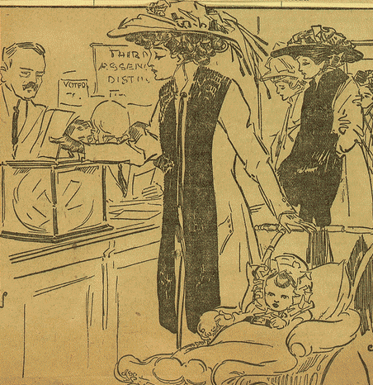
Erosion of the “Separate Spheres”
Women’s rights campaigners began to challenge these laws with increasing vigor in the mid-to-late nineteenth century.
Over the course of the second half of the nineteenth century, many states slowly began to change their laws.
Some western territories also permitted women to vote beginning in the late 1860s and early 1870s
However, most states did not grant full voting rights to women until 1920.
Cartoon of women voters (circa 1909)
Courtesy: Library of Congress

Slide 7
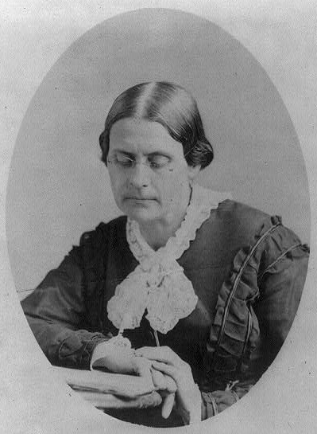
Susan B. Anthony
Susan B. Anthony was a leading advocate for women’s suffrage.
She and fourteen other women voted in New York in the 1872 federal election.
The women, and the election officials who permitted them to vote, were later arrested.
They were indicted under a federal law that made it illegal to vote without the right to do so.
Susan B. Anthony
Courtesy: Library of Congress

Slide 8
The Trial
Anthony’s trial took place in the U.S. Circuit Court for the Northern District of New York.
Circuit courts consisted of a district judge and Supreme Court justice.
They heard most serious federal criminal matters from 1789 to 1911.
In Anthony’s case, the district judge recused himself, so the trial was conducted by Justice Ward Hunt.
Justice Ward Hunt
Courtesy: Library of Congress

Slide 9
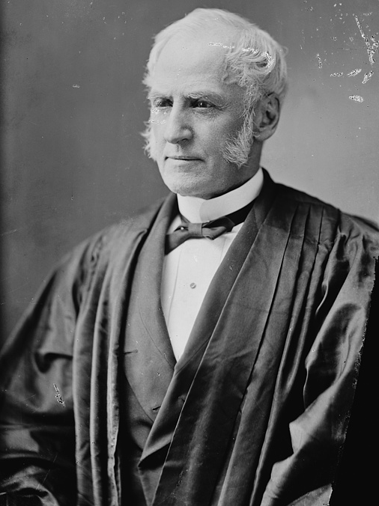
Justice Hunt Rules
Justice Hunt ruled that women did not have a constitutional right to vote.
He agreed that women were citizens, but held this did not give them voting rights.
Recent Supreme Court cases had adopted a narrow view of the “privileges” and “immunities” of national citizenship.
Hunt also reasoned that children and the insane were also citizens, but that states properly restricted their right to vote.
Justice Ward Hunt
Courtesy: Library of Congress

Slide 10
Justice Hunt Rules
Justice Hunt went on to determine there were no factual issues for the jury to decide.
He reasoned that the only relevant questions were whether Anthony was woman and whether she cast a ballot.
Both of these facts were uncontroverted.
Hunt thus ordered the jury to find Anthony guilty.
Justice Ward Hunt
Courtesy: Library of Congress

Slide 11
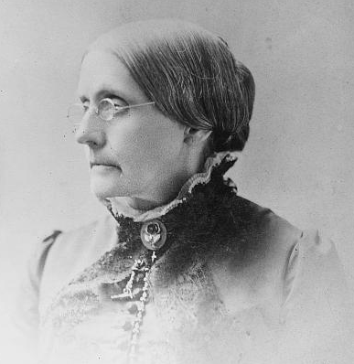
Anthony’s Speech
Justice Hunt asked Anthony whether she had anything to say before he passed judgment.
In response, she delivered a stirring speech denouncing the trial process as sexist and unfair.
She claimed Hunt had failed to provide “even … a trial not of my peers” (a jury of men).
Anthony also argued that Hunt’s decision had “degraded” women “from the status of a citizen to that of a subject.”
Susan B. Anthony
Courtesy: Library of Congress

Slide 12
No Appeal
At the time, federal statutes provided very few mechanisms for appealing criminal verdicts to the Supreme Court of the United States.
Had Anthony been imprisoned, she would have able to seek a writ of habeas corpus demanding her release on constitutional grounds.
But Justice Hunt opted only to impose a fine, from which Anthony had no right to appeal or petition.

Slide 13
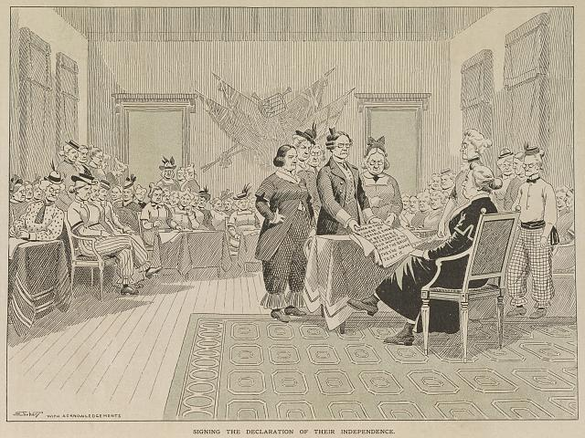
Legacy of the Case
Although Anthony was convicted, she refused to pay her fine.
Anthony’s case became an important symbolic moment in the fight for women’s suffrage.
Her speech at the end of the case became one of the most famous in the women’s movement.
Satirical portrait of Anthony signing women’s “Declaration of Independence” (1911)
Courtesy: Library of Congress

Slide 14
Legacy of the Case
Many observers criticized Justice Hunt’s decision and, particularly, his refusal to let the jury decide the case.
The women’s suffrage movement gained political momentum in the late nineteenth and early twentieth centuries.
The 19th Amendment was ratified in 1920, prohibiting discrimination on the basis of sex at the polls.
Satirical portrait of Anthony signing women’s “Declaration of Independence” (1911)
Courtesy: Library of Congress

