Slide 1
United States v. Smith and Ogden
Federal Trials and Great Debates
in United States History

Slide 2
Introduction
In 1806, William Smith and Samuel Ogden were prosecuted for violating American neutrality by planning to liberate modern-day Venezuela from Spain.
The defendants claimed that President Thomas Jefferson and Secretary of State James Madison had originally approved the mission.
The trial was controversial, with many claiming it represented a political conflict between Jeffersonians and Federalists.
Juries acquitted the defendants in separate trials despite a damning set of instructions from District Judge Matthias Tallmadge.

Slide 3
Tensions with Spain
In the early 1800s, the United States and Spain nearly came to war.
Spain objected to America’s purchase of the Louisiana Territory from France in 1803.
The two countries disagreed as to who owned several parts of the large region involved in the purchase.

Slide 4
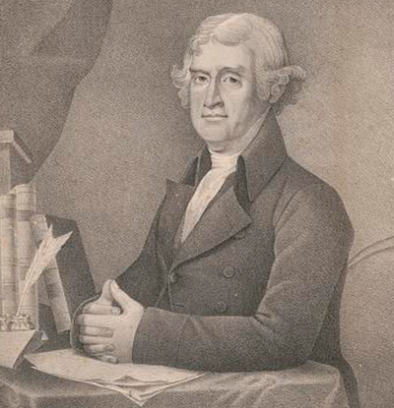
Tensions with Spain
Spain captured several American ships and attempted to disrupt trade in the important port of New Orleans.
In 1805, President Jefferson reported several complaints against Spain to Congress and asked it to consider declaring war.
Thomas Jefferson

Slide 5
Miranda’s Mission
Francisco de Miranda travelled to the United States in late 1805.
Miranda was a former officer in the Spanish army from modern-day Venezuela.
He was determined to free Venezuela from the Spanish Empire.
Miranda believed Americans would support his cause because of the tensions with Spain.
Francisco de Miranda

Slide 6
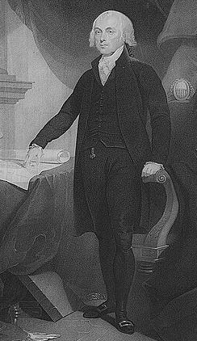
Meetings in Washington
Miranda had meetings with Jefferson and Madison.
Miranda claimed the American leaders quietly approved of his plan to launch a liberation mission.
Madison later denied this, claiming that he had only said that he could not prevent the legal conduct of citizens supporting Miranda’s cause.
James Madison

Slide 7
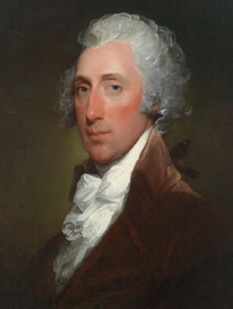
William Stephens Smith
Miranda asked his close friend Smith for assistance.
Smith was the son-in-law of former president John Adams.
He was a member of the Federalist Party, which generally opposed Jefferson’s policies.
He supported Miranda’s plans and allowed his teenage son to go to Venezuela with Miranda.
William Stephens Smith

Slide 8
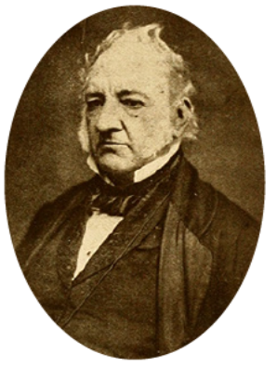
Preparing the Expedition
Smith introduced Miranda to Ogden, a New York merchant who owned a ship called the Leander.
Together, the three men organized a naval expedition.
Miranda planned to sail the Leander to Haiti, where he would be reinforced by more ships.
Samuel Ogden as an older man

Slide 9
Preparing the Expedition
Miranda would then land in the Spanish colony, where he hoped to inspire locals to rise up against their oppressors.
Ogden agreed to pay for most of the cost of the mission in return for Miranda’s promise to conduct trade on his behalf.
Ogden and Smith also helped to recruit soldiers and sailors for the mission.
Samuel Ogden as an older man

Slide 10
Controversy with Spain
Miranda left on his expedition in early 1806.
Shortly after his departure, Spain complained that the United States government had secretly approved the mission.
Seeking to avoid further tensions, the Jefferson Administration assured Spain it would investigate any Americans who had aided Miranda.

Slide 11
Investigations
Judge Matthias Tallmadge conducted interrogations of Smith and Ogden.
Based on these interrogations, Jefferson’s attorney general advised him that Smith and Ogden had violated the Neutrality Act of 1794.
Judge Matthias Tallmadge

Slide 12
Investigations
This law made it a crime to organize military acts against any nation with whom America was “at peace.”
Jefferson ordered Smith and Ogden prosecuted in Tallmadge’s U.S. Circuit Court for the District of New York.
Judge Matthias Tallmadge

Slide 13
Pretrial Issues
Smith and Ogden’s lawyers complained that Tallmadge had improperly acted as both investigator and judge.
The defense claimed that the government had approved of their activities and called Madison and several other senior officials to testify.
Jefferson told the officials not to comply with subpoenas ordering them to attend the trials.
Defense attorney Cadwallader Colden

Slide 14
Pretrial Issues
The defense argued that the trials could not continue without these witnesses and that the court should punish Madison and the others for disrespecting the court.
The defense also claimed the witnesses’ refusal to testify showed that the prosecutions were politically motivated.
Defense attorney Cadwallader Colden

Slide 15
Justice Paterson Rules
Supreme Court Justice William Paterson ruled on the pretrial matters with Judge Tallmadge.
Justice Paterson ruled that the trials could continue without Madison and the other officials.
He reasoned that not even the president could authorize individuals to break the law.
As such, it was irrelevant whether Jefferson and Madison had approved of Miranda’s mission.
Justice William Paterson

Slide 16
Justice Paterson Rules
Justice Paterson and Judge Tallmadge disagreed as to whether Madison and the others should be punished for refusing to come to court.
However, Paterson had to leave the bench due to ill health, and Judge Tallmadge heard the rest of the trials alone.
Because the defendants eventually won at trial, they did not appeal to the Supreme Court, and this legal issue remained unresolved.
Justice William Paterson

Slide 17
The Smith Trial
The prosecution was represented by U.S. Attorney Nathan Sanford and Connecticut federal judge Pierpont Edwards.
The prosecution made a strong case that Smith had collaborated with Miranda’s military mission to a Spanish colony.
The government argued that, since Congress had not declared war on Spain, this was all that was needed to convict.
Judge Pierpont Edwards

Slide 18
The Smith Trial
The defense argued that America and Spain had not really been “at peace” when Smith helped plan the mission.
They also argued that the government had unfairly approved of the mission and then prosecuted Smith to avoid political embarrassment.
Prosecutor Nathan Sanford

Slide 19
Jury Nullification
Judge Tallmadge gave instructions to the jury that made it clear he thought Smith was guilty.
However, defense attorneys argued for jury nullification.
This process, no longer in common usage, allowed juries to disregard judges’ instructions to acquit defendants.
The jury found Smith not guilty.

Slide 20
The Ogden Trial
Despite losing in the Smith trial, the government continued to try Ogden.
The defense argued that this showed the prosecutions were political and vindictive.
The jury again disregarded Judge Tallmadge’s instructions and found Ogden not guilty.

Slide 21
Miranda’s Failure
Miranda’s mission failed shortly after the trials concluded.
Many of his men, including Smith’s son, were captured by the Spanish.
Miranda retreated from Venezuela in a matter of days having failed to gain support for his revolution.
However, many now see the failed mission as a precursor to later successful South American revolutions against Spanish rule.

Slide 22
Aftermath and Legacy
The Smith and Ogden verdicts were perceived very differently by members of the Jeffersonian and Federalist factions.
Many Federalists believed the trials showed that Jefferson and Madison were dishonest and vengeful.
Some claimed that the trials showed the Jeffersonians planned to use the federal courts to settle political scores.

Slide 23
Aftermath and Legacy
While many Federalists were critical of the judiciary’s handling of the case, some argued the cases showed the virtues of the jury system.
Many Jeffersonians claimed that the government and the courts had acted properly and that the trials showed that the jury had ruled based on political sympathies and unfounded rumors.

