Slide 1
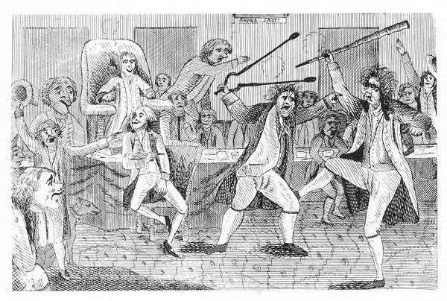
The Sedition Act Trials
Courtesy: Library of Congress
Federal Trials and Great Debates
in United States History

Slide 2
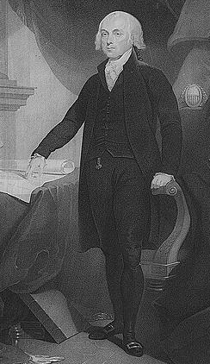
Early Political Parties
The framers hoped to avoid party politics.
They worried that parties would cause division and corruption.
James Madison argued the Constitution’s structure would “break and control the violence of faction.”
However, major figures soon divided on big ideological questions.
James Madison
Courtesy: Library of Congress

Slide 3
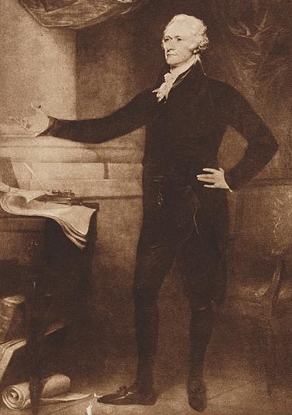
Early Political Parties
Federalists, led by John Adams and Alexander Hamilton:
  Believed in a strong federal government.
  Favored a capitalist economy.
  Felt society should be run by a wealthy elite.
Republicans, led by Madison and Thomas Jefferson:
  Believed in a limited federal government.
  Favored an agricultural economy.
  Wanted greater equality (at least among white men).
Alexander Hamilton
Courtesy: Library of Congress

Slide 4
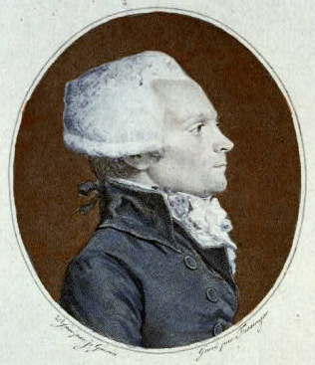
The Quasi-War with France
Beginning in 1789, France underwent an increasingly radical revolution.
Many Americans initially sympathized with the revolution’s call for liberty and equality.
The revolutionaries killed King Louis XVI and declared war on Britain in 1793.
Maximilien Robespierre, a controversial leader of the French Revolution
Courtesy: Library of Congress

Slide 5
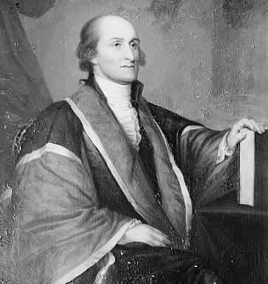
The Quasi-War with France
Federalists wanted an alliance with Britain while Republicans remained more sympathetic to France.
Adams narrowly defeated Jefferson in the election of 1796 and signed a treaty with Britain.
France treated this as a hostile act and seized several American vessels, leading to fears of war.
Republicans criticized Adams’ handling of the crisis.
Former Chief Justice John Jay negotiated the treaty with Britain
Courtesy: Library of Congress

Slide 6
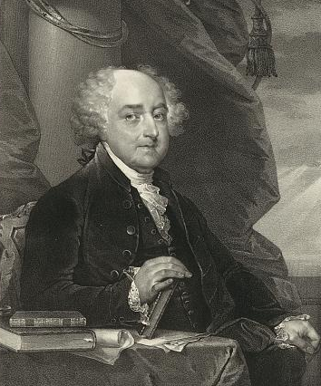
The Sedition Act
In 1798, Congress passed the Sedition Act, which made falsely criticizing the government a crime.
The maximum sentence was two years in prison and a $2,000 fine.
The act was set to expire at the end of Adams’ term.
Some claimed it was designed to keep Federalists in power.
Republicans argued the act was unconstitutional.
John Adams
Courtesy: Library of Congress

Slide 7

Two Interpretations of the First Amendment
Federalists | Republicans
Amendment only protected traditional rights under British law. | Amendment enhanced freedoms beyond British traditions.
Government could not stop publication (“prior restraint”). | Government had to allow expression of ideas even if some were wrong or dangerous.
Government could punish wrongful statements and opinions after they had been published. | Opinions could never be “false.”
Emphasized order and stability. | Emphasized political discourse.
“Congress shall make no law . . . abridging the freedom of speech, or of the press[.]”

Slide 8
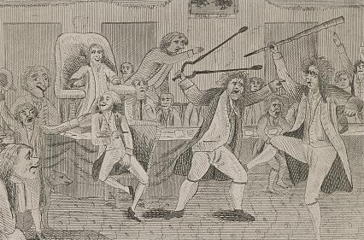
Matthew Lyon
Matthew Lyon was an outspoken Republican member of Congress representing Vermont.
He had previously been involved in a brawl on the floor of the House of Representatives.
He criticized Adams for his “ridiculous pomp” and argued he had mishandled the French crisis.
He was arrested during his re-election campaign.
Caricature of Lyon (center with tongs) fighting in Congress
Courtesy: Library of Congress

Slide 9
The Trial of Matthew Lyon
Lyon and the other Sedition Act defendants were tried in federal circuit court.
Circuit courts were staffed by a district judge and a Supreme Court justice “riding circuit.”
Abolished in 1911, they were the primary federal trial courts at the time.
Riding circuit in Vermont, Justice William Paterson presided in Lyon’s case.
William Paterson
Courtesy: Collections of the Supreme Court of the united States

Slide 10
The Trial of Matthew Lyon
Lyon, defending himself, attempted to call Paterson as a witness.
After answering one question, Paterson declined to allow further interrogation.
Paterson told the jury it could not consider the act’s constitutionality.
The jury found Lyon guilty and Paterson sentenced him to 4 months in prison and a $1,000 fine.
The trial was so unpopular Lyon won re-election from prison.
William Paterson
Courtesy: Collections of the Supreme Court of the united States

Slide 11
The Trial of Thomas Cooper
Thomas Cooper was a newspaper editor who criticized the Adams administration.
He had been forced out of Britain for supporting the French Revolution and was unpopular with Federalists.
Justice Samuel Chase presided over his trial.
Chase told the jury Cooper’s criticisms were “the boldest attempt I have known to poison the minds of the people[.]”
The jury found Cooper guilty and Chase sentenced him to 6 months in prison and a $400 fine.
Thomas Cooper
Courtesy: Library of Congress

Slide 12
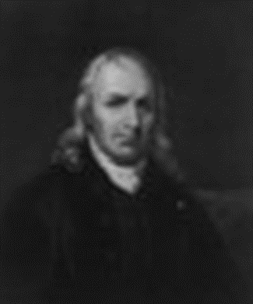
The Trial of James Callender
Callender was an outspoken commentator who had previously revealed Hamilton’s affair with a married woman.
Justice Chase again presided over the trial and made little pretense of neutrality.
Callender’s lawyer withdrew from the case in protest over Chase’s frequent interruptions and arguments.
Callender was found guilty and sentenced to 9 months in prison and a $400 fine.
Samuel Chase
Courtesy: Collections of the Supreme Court of the United States

Slide 13
Other Trials
In all, Federalists arrested twenty-five Republicans.
Ten cases were tried.
All the defendants were found guilty.
The prosecutions seemed to confirm that the act was a tool of Federalist power.
Many Republicans came to see the judiciary as partisan.

Slide 14
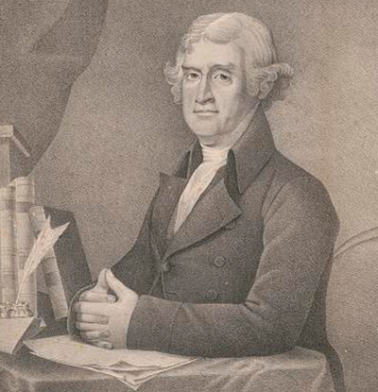
Aftermath and Legacy
Jefferson narrowly won a contested presidential election in 1800.
He pardoned all those who had been convicted and released any defendants still in custody.
The Supreme Court did not decide the act’s constitutionality before it expired.
Subsequent cases suggested that the act likely violated the First Amendment by stifling dissent.
Thomas Jefferson
Courtesy: Library of Congress

Slide 15
Aftermath and Legacy
Many Republicans remained suspicious of the judiciary for several years.
In 1802, they repealed a law that had created a number of new judicial positions filled by Adams.
The House of Representatives impeached Chase in 1804 but he was acquitted in the Senate.
The relationship between judges and political parties continued to be debated.
However, few judges were ever as openly partisan as Chase and Paterson had been.
Thomas Jefferson
Courtesy: Library of Congress

