Slide 1
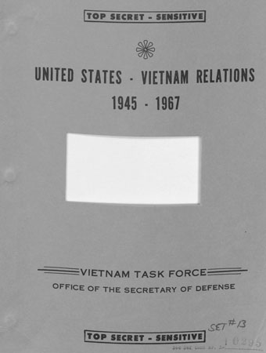
The Pentagon Papers
Miller Center
Federal Trials and Great Debates in United States History

Slide 2
The Pentagon Papers
In 1967, Defense Secretary Robert McNamara began to have doubts about whether the U.S. could win the Vietnam War.
McNamara hoped to provide lessons about American foreign policy to be drawn upon in the future.
He commissioned the Pentagon Papers to preserve the historical record of American policymakers’ decisions regarding Vietnam.
Between 1967 and 1969, a Department of Defense task force created the 47-volume study, officially named United States-Vietnam Relations: 1945-1967.
The study was marked “Top Secret—Sensitive” and few in the government knew of its existence.
Secretary of Defense Robert McNamara Library of Congress

Slide 3
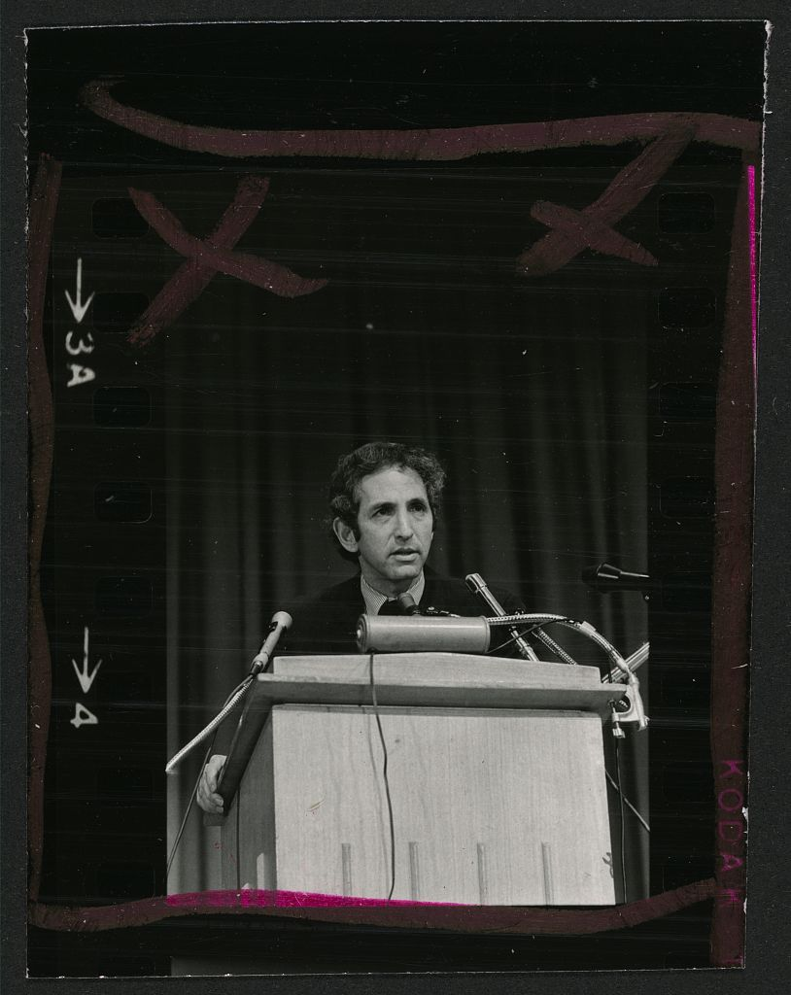
Daniel Ellsberg
Ellsberg was a former U.S. Marine who had worked for the Defense Department and the RAND Corporation, a research institute assisting the U.S. military.
He was involved in planning Vietnam strategy and participated in the Pentagon Papers project.
He spent time in Vietnam during the war on behalf of the State Department.
Originally a strong supporter of the war, Ellsberg later became disillusioned.
Ellsberg urged several government officials to make the Pentagon Papers public.
When they refused, he began copying the study in 1969 and delivered it to Neil Sheehan of The New York Times in 1971.
Daniel Ellsberg Library of Congress

Slide 4
The New York Times
The Times published its first story about the Pentagon Papers on June 13,1971.
The article discussed the 1964 Tonkin Gulf Resolution, which gave President Lyndon B. Johnson broad authority to increase U.S. military involvement in Vietnam.
The report cast doubt on the government’s statements about the alleged North Vietnamese attacks on American ships that had been the basis for the resolution.
The U.S. had been making clandestine attacks on North Vietnam prior to the Tonkin Gulf incident, and the White House had drafted a congressional resolution in advance.

Slide 5
The New York Times
The Times’s initial coverage showed that the Johnson Administration had reached a consensus before the 1964 election to bomb North Vietnam, even as Johnson ran as the candidate of “restraint and reason” against Barry Goldwater.
Also, Johnson had concealed from the public his April 1965 decision to send ground troops to Vietnam for offensive action.
A consistent theme of the coverage was that every administration from Harry Truman’s to Johnson’s had misled the public about Vietnam.

Slide 6
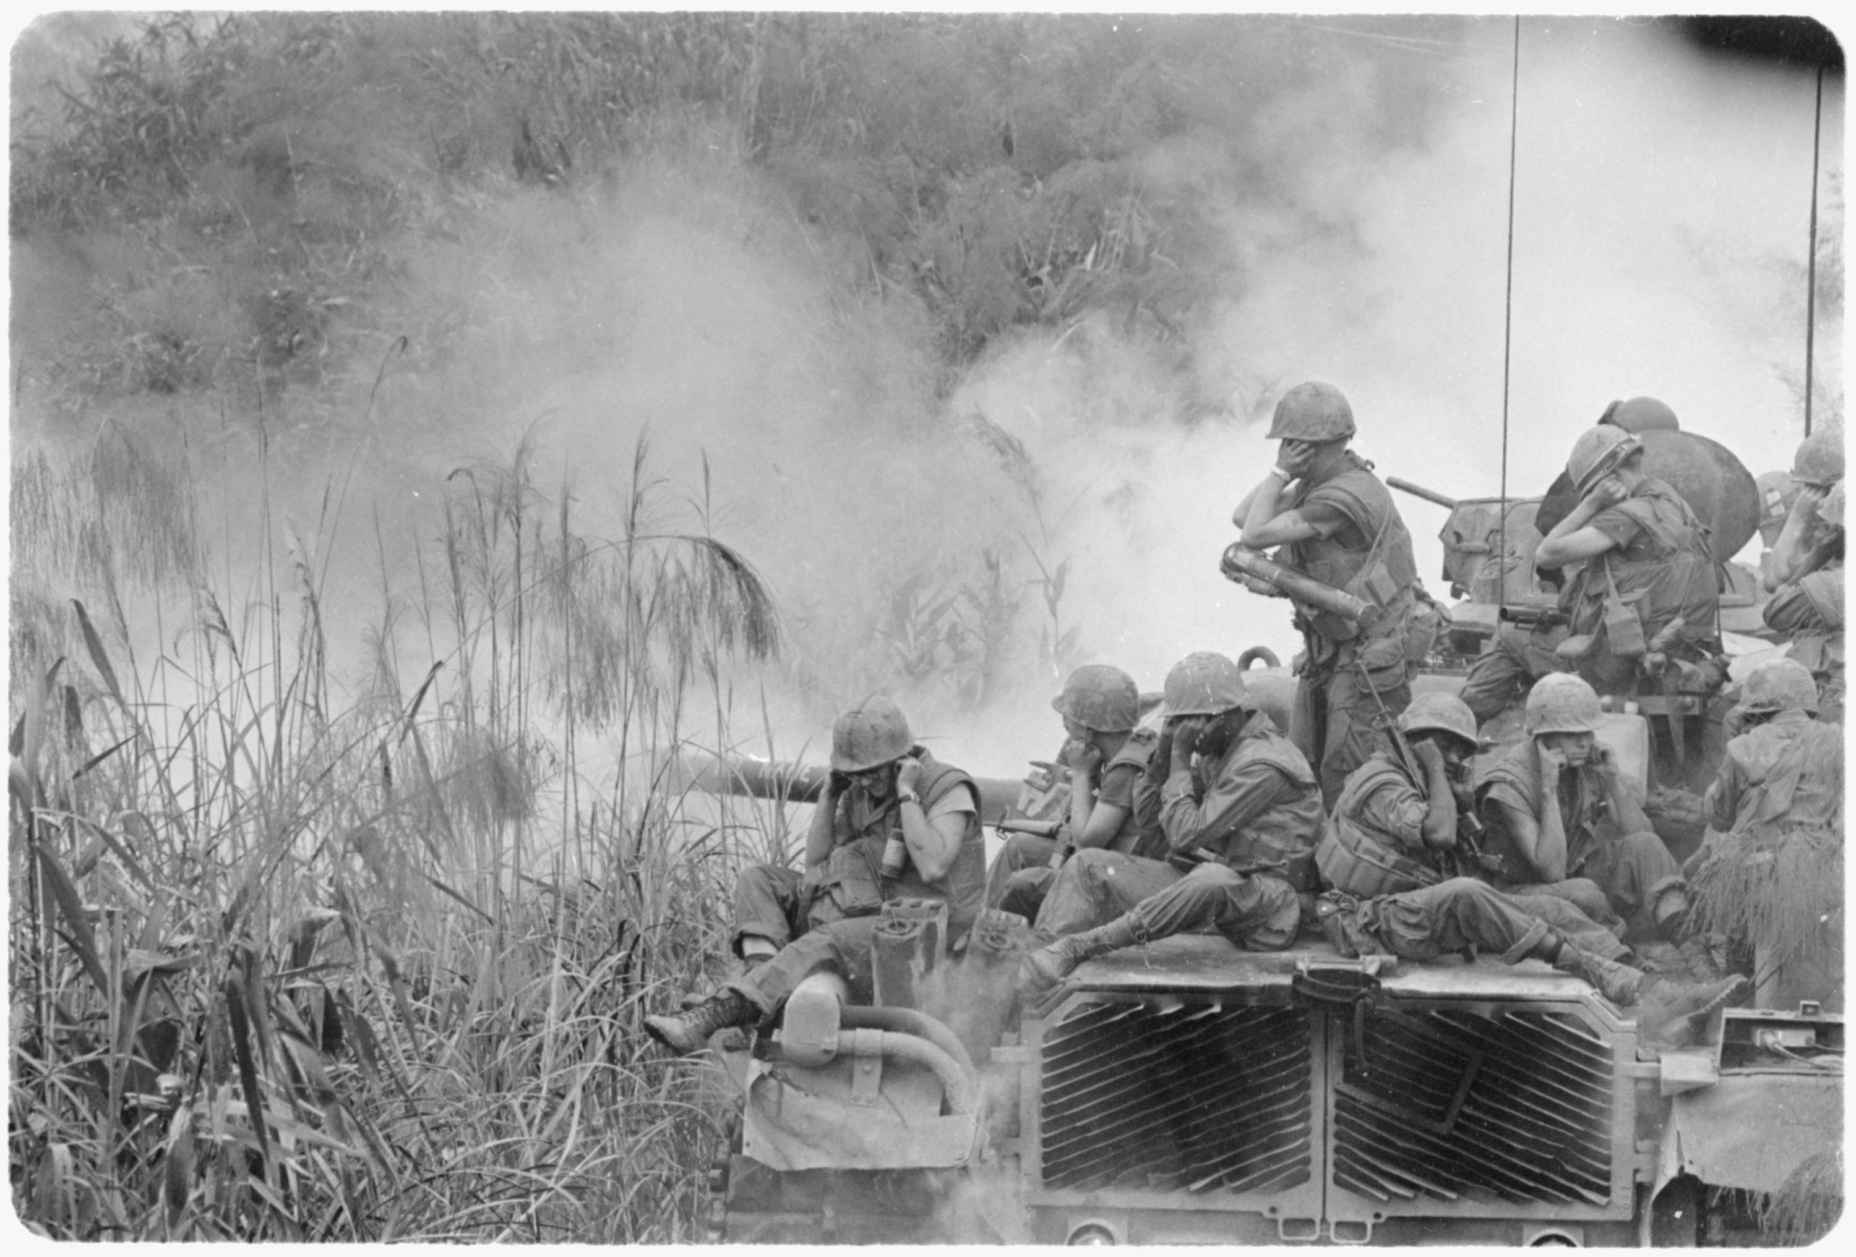
The Vietnam War
When the Pentagon Papers became public, many Americans were already angry and pessimistic about the war.
Many believed the U.S. should not interfere in the fate of a foreign country and that the U.S.-supported government in South Vietnam was repressive and corrupt.
Some also felt that the war was unwinnable.
Complaints included the killing of Vietnamese civilians, mounting American casualties, and the unfairness of the draft.
There was widespread suspicion that the government had been lying about the war.
National Archives

Slide 7
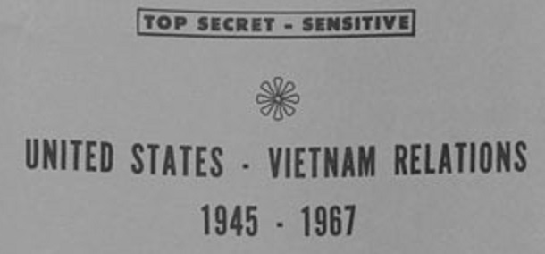
Government Secrecy
The Pentagon Papers case was part of a long-running debate about government secrecy.
The modern classification system arose from the need to protect American secrets from the Soviet Union during the Cold War.
Many believed the government abused its classification power.
Journalists were concerned that they lacked the information to properly report on what the government was doing.
Cover of the Pentagon Papers Miller Center

Slide 8
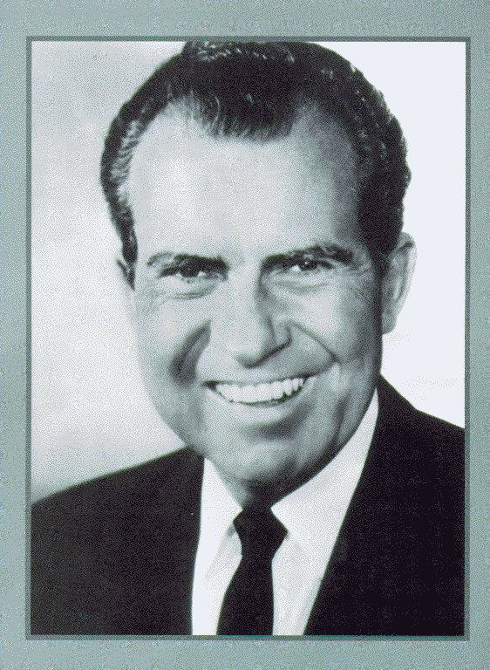
White House Reaction
President Richard Nixon was at first unconcerned with the revelations in the Pentagon Papers because they cast a negative light on Presidents Kennedy and Johnson.
Nixon wanted the leaker found and prosecuted.
After speaking with his advisors, Nixon changed course and decided that the newspapers should be prohibited from publishing the Pentagon Papers.
Nixon claimed the government could not function if classified information could not be protected.
President Richard M. Nixon Central Intelligence Agency

Slide 9
Prior Restraint
A prior restraint is a ban on publication before the fact, as opposed to seeking criminal charges afterward.
American judges had long interpreted the First Amendment to bar prior restraint.
Near v. Minnesota (1931) held prior restraint generally unconstitutional, permissible only in extreme circumstances such as “publication of the sailing dates of transports or the number and location of troops.”
Chief Justice Charles Evans Hughes Author of Near Opinion
Library of Congress

Slide 10
U.S. v. New York Times
The Department of Justice sought a temporary restraining order and a preliminary injunction against the Times.
U.S. District Judge Murray Gurfein granted the restraining order but, after holding a hearing, denied the injunction.
The U.S. Court of Appeals for the Second Circuit remanded the case to Gurfein for an additional hearing on a “special appendix” the government had filed.
The Supreme Court took the case before the hearing could be held.
Judge Murray Gurfein American Jewish Hist. Soc.

Slide 11
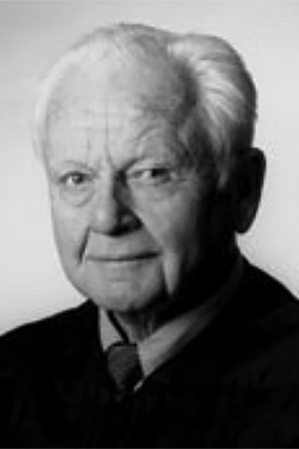
U.S. v. Washington Post
While the Times was restrained from further publication of the Pentagon Papers, the Post began its own series of articles, and the government sued.
U.S. District Judge Gerhard Gesell denied a temporary restraining order.
The U.S. Court of Appeals for the District of Columbia Circuit reversed Gesell by a 2-1 vote.
After a hearing, Gesell denied a preliminary injunction, and the D.C. Circuit affirmed.
Judge Gerhard Gesell D.C. Circuit Hist. Soc.

Slide 12
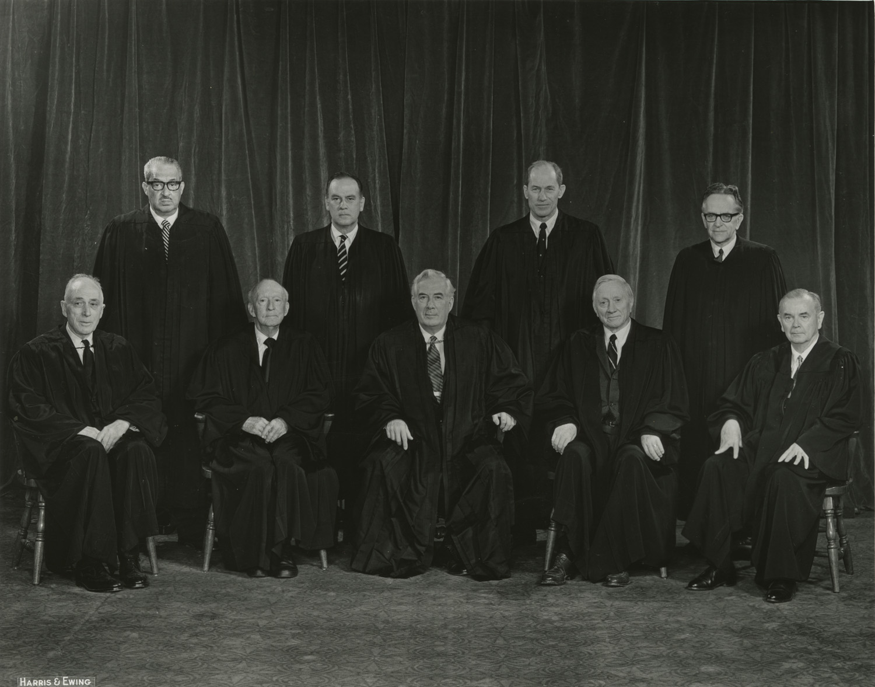
The Supreme Court
Solicitor General Erwin Griswold argued that further publication would harm national security and infringe on the President’s authority to conduct foreign affairs.
The government filed a secret brief identifying specific parts of the Pentagon Papers that would be harmful if disclosed.
Lawyers for the newspapers argued that the government had failed to provide enough evidence of harm to justify a prior restraint.
Supreme Court of the U.S.

Slide 13
The Supreme Court
The Court voted 6-3 to deny a prior restraint and allow the newspapers to continue publication.
The Court issued its ruling in a brief opinion, and all nine justices filed concurring or dissenting opinions.
The concurring justices emphasized the importance of press freedom and the severity of prior restraint.
The dissenters felt that the government had not had sufficient time to prove that publication would threaten national security.
Supreme Court of the U.S.

Slide 14
Aftermath and Legacy
In 1973, Ellsberg was tried for theft and espionage in federal court in Los Angeles.
The charges against him were dismissed after revelations of government misconduct, including illegal surveillance and the burglary of Ellsberg’s psychiatrist’s office.
A White House unit nicknamed the “Plumbers,” which spied on Ellsberg, committed the 1972 burglary that sparked the Watergate scandal.
Daniel Ellsberg Library of Congress

Slide 15
Aftermath and Legacy
The revelations contained in the Pentagon Papers confirmed the suspicions of many Americans that the government had misled the public about the Vietnam War.
The episode also worsened general mistrust of government, which was soon exacerbated by Watergate.
Nevertheless, the Pentagon Papers case is hailed as a landmark victory for freedom of the press.

