Slide 1
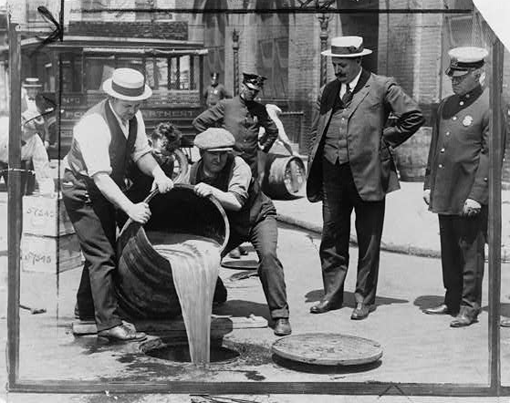
Olmstead v. United States
Courtesy: Library of Congress
Federal Trials and Great Debates
in United States History

Slide 2
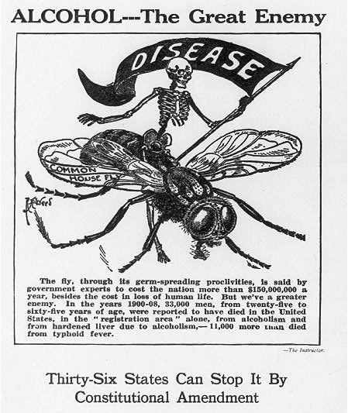
National Prohibition
Groups of social reformers sought to ban alcohol throughout the 19th and early 20th centuries.
These efforts gathered momentum in the Progressive Era (circa 1890s-1920s).
Progressives emphasized the social causes of problems like disease, broken homes, and crime.
Alcohol was a leading cause of all these issues.
A 1917 campaign for the 18th Amendment Courtesy: Library of Congress

Slide 3
National Prohibition
Several states and counties prohibited alcohol in the Progressive Era.
The 18th Amendment was ratified in 1919 and became effective in 1920.
It banned “the manufacture, sale, or transportation of intoxicating liquors” nationwide.
The Amendment gave the state and federal governments joint power to administer prohibition.
A 1917 campaign for the 18th Amendment Courtesy: Library of Congress

Slide 4
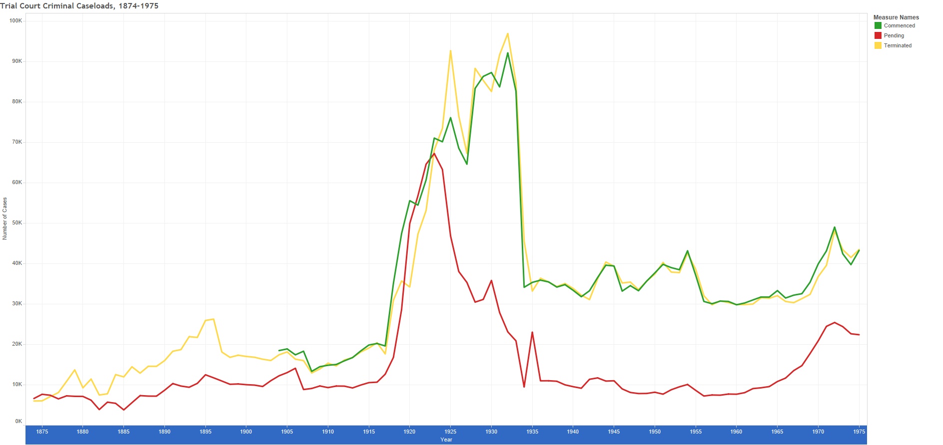
More work for the Federal System
The federal government took on most of the work of enforcing prohibition.
The Volstead Act (1919) imposed federal criminal penalties for alcohol offenses.
As a result, the workload of the federal courts increased rapidly over the 1920s.
Federal investigators gained significantly more power.
Federal criminal caseloads increased during prohibition
www.fjc.gov/history

Slide 5
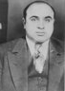
Organized Crime
Most Americans obeyed prohibition more closely than some popular depictions suggest.
However, there was still a considerable demand for illegal alcohol.
This created an incentive for criminals to manufacture and sell “bootlegged” liquor.
Alcohol-related violence was widespread in cities like Chicago.
Al Capone built a crime empire
around illegal alcohol
Courtesy: Library of Congress

Slide 6
Roy Olmstead
Roy Olmstead was one the leading “bootleggers” in the northwest.
Olmstead was a former Seattle police officer.
He left the force in disgrace after pleading guilty to a minor alcohol charge.
He then built a large criminal organization.
Roy Olmstead with his wife Elise
Courtesy: Museum of History and Industry, Seattle Washington

Slide 7
Roy Olmstead
His gang illegally imported alcohol from Canada on ships supposedly bound for Mexico.
Olmstead’s gang was bigger and better funded than the group of federal agents investigating him.
His police contacts also helped him avoid detection and capture.
Roy Olmstead with his wife Elise
Courtesy: Museum of History and Industry, Seattle Washington

Slide 8
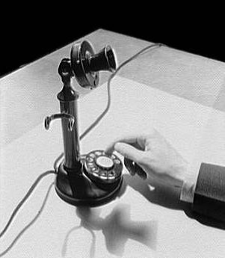
Wiretaps
Federal agents wiretapped Olmstead’s home and office phones to gather evidence.
Wiretapping was illegal in Washington state.
An informant told Olmstead about the wiretaps and offered him the transcripts of the conversations for a fee.
Olmstead refused, believing such evidence would be inadmissible in court.
In 1924, federal authorities arrested Olmstead and dozens of others.
They used information from Canadian police in conjunction with evidence from the wiretaps.
Courtesy: Library of Congress

Slide 9
The Trial
Olmstead was tried in the U.S. District Court for the Western District of Washington.
At trial, witnesses used the transcripts of wiretapped conversations to refresh their recollections.
District Judge Jeremiah Neterer permitted the admission of records and other evidence obtained via the wiretaps.
Olmstead was convicted and sentenced to four years imprisonment and an $8,000 fine.
District Judge Jeremiah Neterer
Courtesy: U.S. District Court for the Western District of Washington

Slide 10
Court of Appeals
Olmstead appealed to the U.S. Court of Appeals for the Ninth Circuit.
He argued that the use of evidence from the wiretaps violated the 4th Amendment’s ban on unreasonable searches and seizures.
He also argued that the use of his phone conversations violated the 5th Amendment rule against compelled self-incriminating testimony.
The court ruled against Olmstead in a 2-1 opinion written by Judge William Ball Gilbert.
Judge William Ball Gilbert
Courtesy: Ninth Circuit U.S. Court of Appeals Library

Slide 11
Court of Appeals
Judge Gilbert reasoned that the 4th Amendment prohibited the government from intruding in individuals’ homes.
It did not protect all private conversations from detection.
Judge Frank Rudkin dissented from the court’s decision.
He argued that both the 4th and 5th Amendments were designed to preserve a broader right to privacy.
Judge William Ball Gilbert
Courtesy: Ninth Circuit U.S. Court of Appeals Library

Slide 12
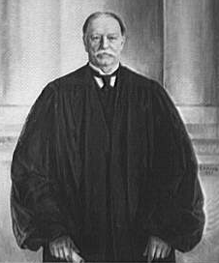
The Supreme Court Rules
In a 5-4 decision, the Supreme Court of the United States upheld the Court of Appeals’ decision.
Chief Justice William Howard Taft adopted a strict interpretation of the text of the 4th and 5th Amendments.
The 5th Amendment, he reasoned, only applied when a defendant was “compelled . . . to be a witness against himself.”
No one had “compelled” Olmstead to talk on the phone, so the 5th Amendment was not relevant.
Chief Justice William Howard Taft
Courtesy: Library of Congress

Slide 13
The Supreme Court Rules
Most of Taft’s opinion focused on the 4th Amendment.
Taft noted that the Amendment mentioned the security of “persons, houses, papers, and effects,” but not conversations.
The wiretaps did not involve a physical search of Olmstead’s house, body, or belongings.
Taft argued the Amendment could not be stretched “to include telephone wires reaching to the whole world from [Olmstead’s] house or office.”
Chief Justice William Howard Taft
Courtesy: Library of Congress

Slide 14
Brandeis Dissents
The 4 dissenting justices wrote separate opinions.
The most significant of these was Justice Louis Brandeis’.
In 1890, Brandeis had co-written an influential article supporting a legal right to privacy.
In Olmstead, he argued the 4th and 5th Amendments protected that right.
Justice Louis D. Brandeis
Courtesy: Library of Congress

Slide 15
Brandeis Dissents
Brandeis stressed that the Constitution should be read flexibly.
He argued the amendments were designed to protect broad principles, not to regulate specific conduct.
The Constitution had to adapt to developments its framers could not have foreseen, including the telephone.
He also argued evidence related to the wiretaps should not have been used because its collection violated state law.
Justice Louis D. Brandeis
Courtesy: Library of Congress

Slide 16
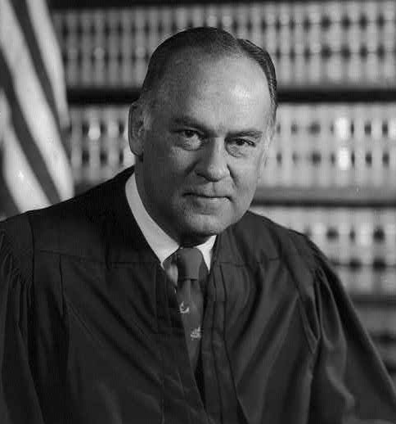
Aftermath and Legacy
National prohibition ended with the ratification of the 21st Amendment in 1933.
Brandeis’ view of right to privacy under the 4th and 5th Amendments laid the groundwork for many later cases.
In Katz v. United States (1967), the Supreme Court overturned Olmstead.
Privacy rights have played an increasingly important role in many other areas of the law, including reproductive rights.
Justice Potter Stewart wrote the decision overturning Olmstead
Courtesy: Library of Congress

