Slide 1
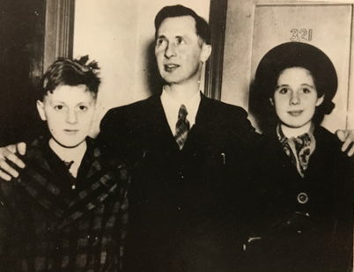
The Flag Salute Cases
William, Walter, and Lillian Gobitis
Courtesy: Library of Congress
Federal Trials and Great Debates
in United States History

Slide 2
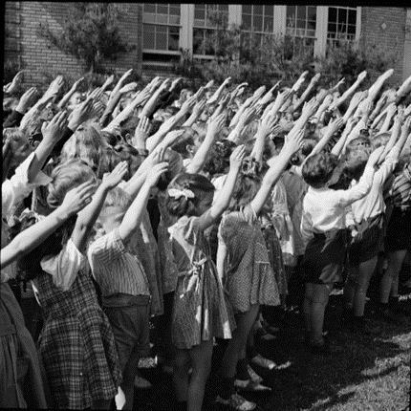
Flag Salute Requirements
Prior to World War II, many states passed laws requiring students to salute the flag.
Most of these rituals involved the Pledge of Alliance and a raised-arm salute, usually with the palm upturned.
Even in states where there was no such law, many schools and school districts required their students to participate.
Connecticut school children salute the flag
Courtesy: Library of Congress

Slide 3
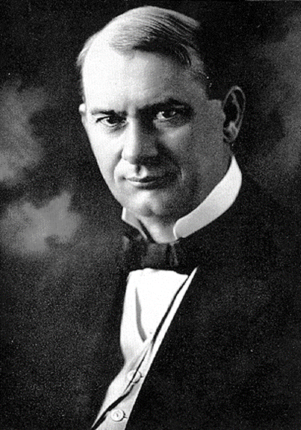
Jehovah’s Witnesses
The Jehovah’s Witnesses believed in a strict interpretation of the bible.
Joseph Rutherford, the Witnesses’ leader, claimed saluting the flag was worshipping a “graven image.”
Many Witness children refused to salute the flag.
Joseph Rutherford (ca. 1910)
Produced by the Watchtower Bible and Tract Society, public domain

Slide 4
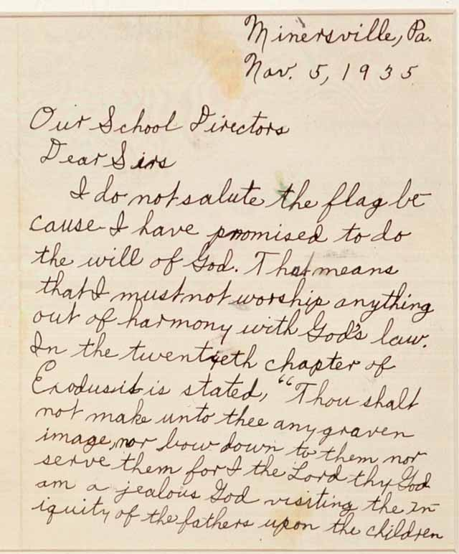
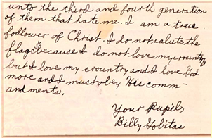
The Gobitases Resist
William and Lillian Gobitas were Jehovah’s Witnesses attending public school in the small town of Minersville, PA.
In 1935, they both refused to salute the flag.
The local school board created a rule requiring the pledge and salute.
Once the board passed this rule, the superintendent immediately expelled the Gobitases.
William, aged 10, wrote to the school board explaining why he could not salute the flag
Courtesy: Library of Congress

Slide 5
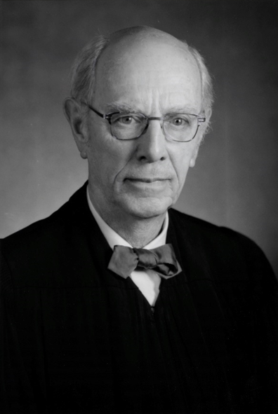
Trial and Appeal
Walter Gobitas sued the school district in federal court.
He argued the flag salute violated his children’s religious freedoms.
District Judge Albert Maris ruled in the Gobitases’ favor.
The school district appealed to the Court of Appeals for the Third Circuit, which upheld Judge Maris’ ruling.
The school district then appealed to the Supreme Court of the United States.
Judge Albert B. Maris (ca. 1980s)
Courtesy: The Honorable Albert Branson Maris Papers, Third Circuit Libraries.

Slide 6
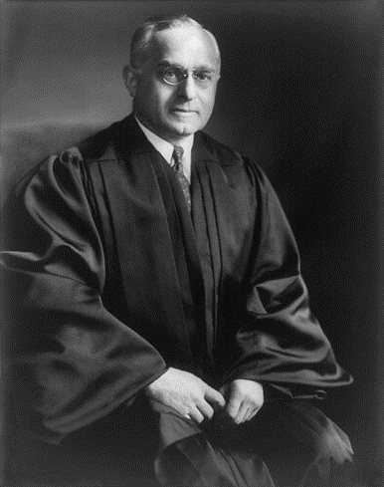
The Supreme Court Rules (1940)
Justice Felix Frankfurter wrote an opinion ruling against the Gobitases.
Frankfurter was known for a philosophy of “judicial restraint.”
He emphasized that the government had an important interest in creating respect for the flag as “the symbol of our national unity[.]”
Justice Felix Frankfurter
Courtesy: Library of Congress

Slide 7
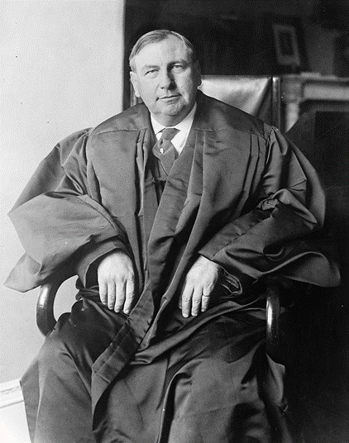
Dissenting Views
Justice Harlan Fiske Stone dissented from the Court’s decision.
He argued that the courts had a duty to protect the freedoms of “politically helpless minorities[.]”
This was so even if the government was acting “in the name of righteousness and the public good[.]”
Justice Harlan Fiske Stone
Courtesy: Library of Congress

Slide 8
Justice in the Balance
Frankfurter and Stone’s opinions reflected different views of the role of courts.
Since federal judges are unelected, Frankfurter thought it was important that courts avoid overturning democratic bodies like school boards.
This was particularly important where a law was justified by important government interests like unity and patriotism.
Stone was worried about majorities overriding the fundamental liberties of unpopular minorities.
He thought real democracy required courts to strike down laws that violated these liberties since minorities could never become majorities if they were unfairly oppressed.
STONE
Fairness
Fundamental Liberties
FRANKFURTER
Judicial Restraint
Patriotism and Unity
Majority Rule

Slide 9
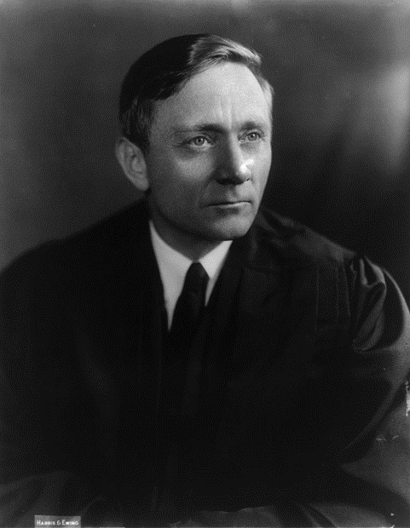
Responses to the Decision
A wave of violence against the Witnesses followed the Court’s decision.
Many of the attackers claimed the Witnesses were unpatriotic.
Some observers blamed the Supreme Court for the violence.
In 1942, three justices, led by William Douglas, stated that they believed the court had incorrectly decided the flag salute issue.
Justice William O. Douglas
Courtesy: Library of Congress

Slide 10
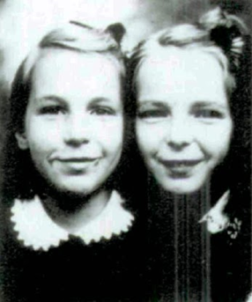
The Barnetts’ Case
In 1942, the West Virginia Board of Education adopted a flag salute regulation mimicking Justice Frankfurter’s opinion.
Gathie and Marie Barnette were sent home from school several times for refusing to salute the flag.
Their father sued under a federal statute that required the trial to be held by three judges.
Under this statute, the Supreme Court had to accept an immediate appeal from the losing party.
Gathie and Marie Barnett
Courtesy: Robert H. Jackson Center

Slide 11
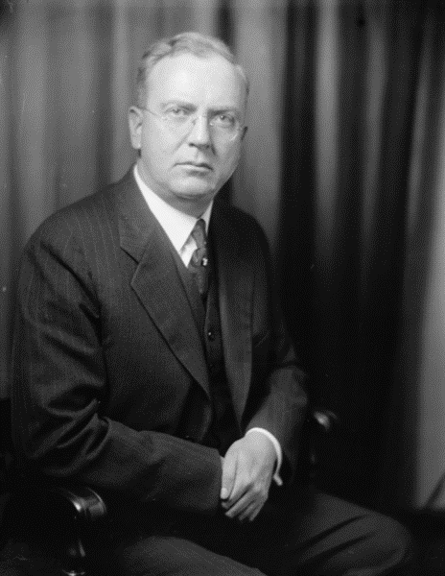
Trial Court Ruling
Judge John J. Parker took the unusual step of predicting that the Court would reverse itself.
The three-judge panel unanimously ruled in favor of the Barnetts.
The board appealed to the Supreme Court.
Judge John Johnson Parker
Courtesy: Library of Congress

Slide 12
The Appeals Process
Minersville School District v. Gobitis
West Virginia Bd. of Ed. v. Barnette
Supreme Court of the U.S.
U.S. Court of Appeals
U.S. District Court
Supreme Court of the U.S.
U.S. Court of Appeals
U.S. District Court

Slide 13
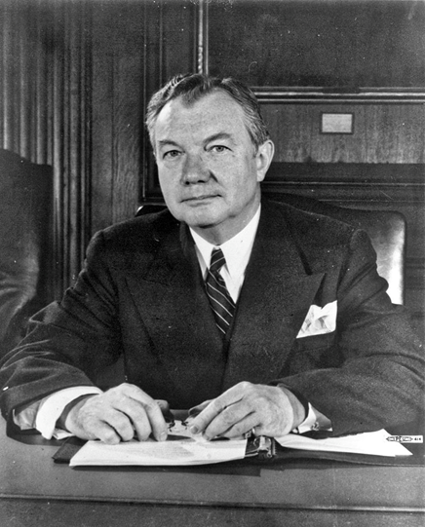
The Supreme Court changes Direction
The Supreme Court voted 6-3 to overturn its earlier decision.
Justice Robert Jackson’s majority opinion reasoned that mandatory salutes unconstitutionally compelled people to declare values they did not hold.
Jackson’s opinion is widely regarded as one of the most eloquent in Supreme Court history.
Justice Robert H. Jackson
Courtesy: Library of Congress

Slide 14
The Supreme Court changes Direction
“If there is any fixed star in our constitutional constellation it is that no official, high or petty, can prescribe what shall be orthodox in politics, nationalism, religion, or other matters of opinion or force citizens to confess by word or act their faith therein.”
“Those who begin coercive elimination of dissent soon find themselves exterminating dissenters. Compulsory unification of opinion achieves only the unanimity of the graveyard.”
Justice Robert H. Jackson
Courtesy: Library of Congress

Slide 15

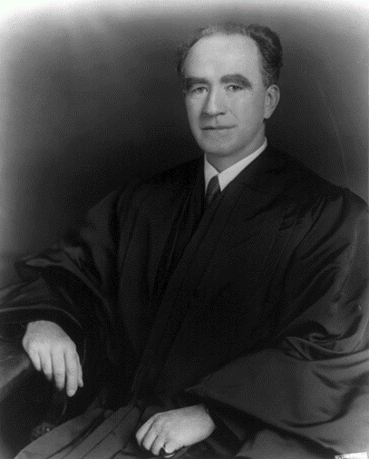
Other Approaches
Justice Frank Murphy wrote a separate opinion that argued the flag salute violated the “free exercise” of religion.
Justice Frankfurter issued a famous dissenting opinion.
Although he personally agreed with the result of the case, he argued that “[a]s a member of this Court I am not justified in writing my private notions of policy into the Constitution, no matter how deeply I may cherish them[.]”
He also claimed that the Court should not have abandoned its own precedent so quickly.
“The Court has no reason for existence[,]” he argued, “if it merely reflects the pressures of the day.”
Justice Felix Frankfurter
Courtesy: Library of Congress
Justice Frank Murphy
Courtesy: Library of Congress

