Slide 1
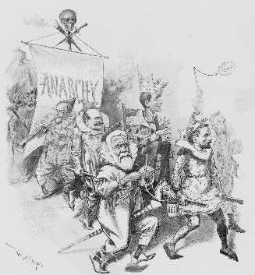
In re Debs
Courtesy: Library of Congress
Federal Trials and Great Debates
in United States History

Slide 2
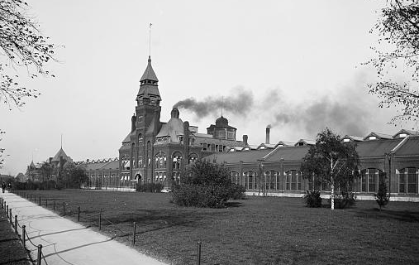
The Pullman Company
The Pullman Palace Car Co. was the nation’s largest railway car manufacturer in the late 19th century.
The company was run by George Pullman, a wealthy industrialist.
In 1880, he constructed the company town of Pullman, Illinois.
It included a factory and homes for many of his workers.
The Pullman factory (circa. 1900)
Courtesy: Library of Congress

Slide 3
The Pullman Company
Workers received two paychecks, one of which they returned to the company for rent if they lived in the town.
Pullman thought the town showed his generosity to employees.
Critics argued corporations like Pullman’s were trying to control workers’ lives.
The company forbade union activity in the town.
The Pullman Palace Car Co. factory (circa. 1900)
Courtesy: Library of Congress

Slide 4
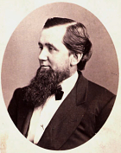
The Pullman Strike Begins
From 1893 to 1897, the United States suffered a severe economic depression.
As demands for Pullman cars dwindled, Pullman fired some workers and sharply reduced the wages of others.
He did not reduce the rents he charged for the houses in the company town.
Workers decided to strike in protest.
George M. Pullman
Courtesy: Smithsonian Institute

Slide 5
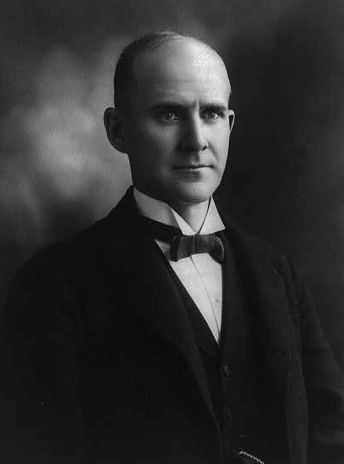
Eugene Debs
Eugene V. Debs was the head of one of the nation’s largest rail unions, the American Railway Union.
In June, 1894, the ARU voted to join the Pullman strike.
Although Debs was initially wary of the strike, he became its figurehead.
Eugene V. Debs
Courtesy: Library of Congress

Slide 6
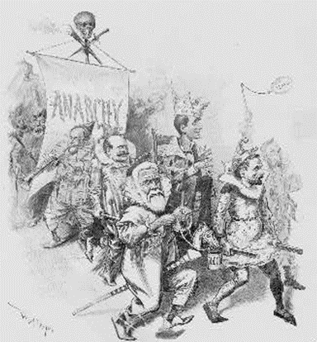
Industrial Action in the 1890s
Strikes were risky in the late 19th century.
Prior to 1935, most workers could be fired for organizing unions or striking.
In some instances, corporations hired private police forces to break up strikes with violence.
Strikers were not always popular with the public.
The Pullman strike was controversial because it came during a depression and the economy relied on rail transport.
Cartoon depicting Debs as
the king of anarchy
Courtesy: Library of Congress

Slide 7
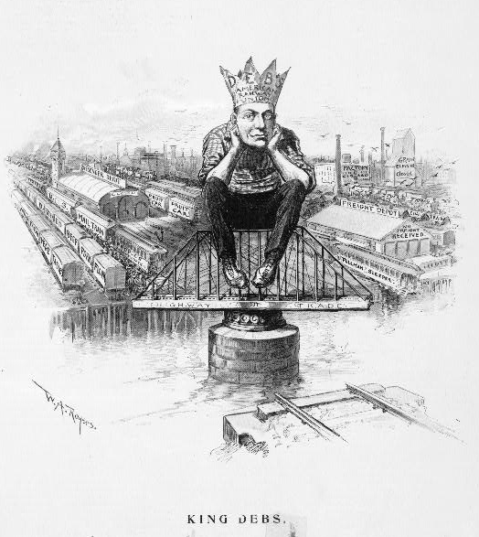
The Pullman Strike
The ARU boycotted all trains carrying Pullman cars and blockaded rail lines.
Tens of thousands of ARU members participated in the strike.
A group of railroad companies fired strikers and attached Pullman cars to their trains.
They refused to move trains from which strikers had removed Pullman cars.
The strike and the railroads’ reaction disrupted almost all rail traffic west of Chicago.
Satirical cartoon depicting
“king” Debs blocking the rails
Courtesy: Library of Congress

Slide 8
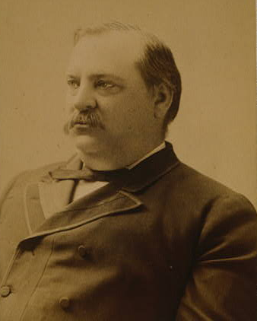
Federal Response
The impasse between the unions and the railroads threatened to deepen the economic crisis.
On July 3, 1894, President Grover Cleveland ordered federal troops into Chicago.
The troops patrolled railyards to stop strikers blockading trains.
President Grover Cleveland
Courtesy: Library of Congress

Slide 9
Federal Response
The government also sought injunctions in federal courts.
Courts across the nation granted dozens of orders against the strike.
The most important came from the U.S. Circuit Court for the Northern District of Illinois, which included Chicago, the center of the strike.
President Grover Cleveland
Courtesy: Library of Congress

Slide 10
Injunctions
Injunctions are court orders prohibiting individuals or groups from committing specified acts.
In this case, the government requested the injunction on three main grounds:
The strike was interfering with the mail;
The strike was interfering with interstate commerce; and
The ARU was violating the Sherman Anti-Trust law, which prohibited “combinations” that restrained trade.
The circuit court issued an injunction against Debs and several other union leaders.

Slide 11
Violence and Contempt of Court
After the court issued the injunction, Debs continued to work with the ARU’s local branches and the strike intensified.
Protesters clashed violently with troops.
30 workers died and many more were injured.
Troops clashed violently with workers
Courtesy: Library of Congress

Slide 12
Violence and Contempt of Court
In the wake of the violence, the Court cited Debs for contempt of court and sentenced him to six months in prison.
Federal authorities also brought a separate criminal prosecution against Debs and his colleagues.
That case was ultimately abandoned.
Troops clashed violently with workers
Courtesy: Library of Congress

Slide 13
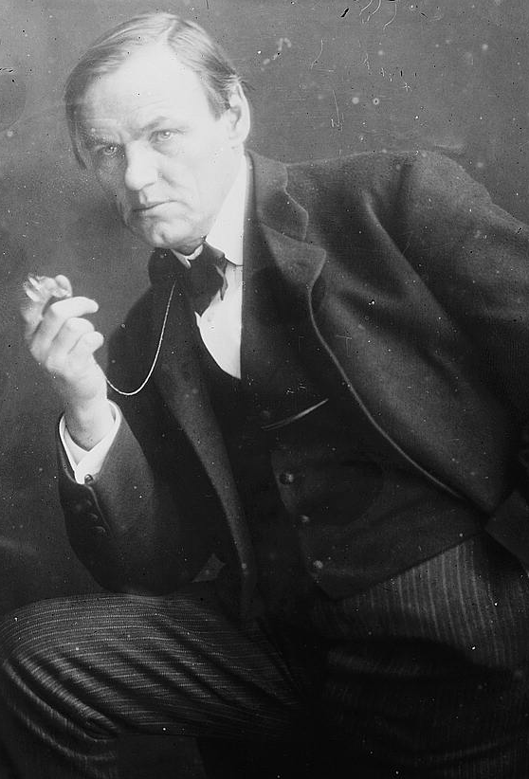
Habeas Corpus
Debs petitioned the Supreme Court for a writ of habeas corpus.
Habeas corpus is a legal mechanism for challenging the validity of a detention.
In this instance, it served as a challenge to the legality of the circuit court’s injunction.
Attorney Clarence Darrow
Courtesy: Library of Congress

Slide 14
Habeas Corpus
Debs’ lawyers included the famed advocate Clarence Darrow and former U.S. Senator Lyman Trumbull.
They argued that the court should not have granted the government an injunction on three grounds:
The government had no legal interests at stake in the case;
The anti-trust law was designed to stop monopolies, not unions;
Debs had been denied his right to a jury trial.
Attorney Clarence Darrow
Courtesy: Library of Congress

Slide 15
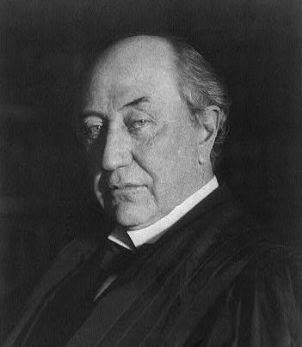
The Supreme Court Rules
The Supreme Court unanimously upheld Debs’ conviction.
Justice David Brewer’s opinion sustained a broad injunction power in labor cases.
Brewer emphasized that the U.S. government had the right to regulate interstate commerce and the mail.
The government had to be able go to courts to enforce its regulations using injunctions.
Justice David Brewer
Courtesy: Library of Congress

Slide 16
The Supreme Court Rules
The Court also held that Debs had not been deprived of his right to a jury.
Judges had the power to issue injunctions without juries.
The ability to punish those who ignored injunctions was an essential part of the injunction power.
The Court did not address whether the Sherman Act applied to unions, but later cases held that it did.
Justice David Brewer
Courtesy: Library of Congress

Slide 17
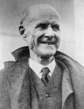
The Aftermath
The ARU dissolved in the wake of In re Debs.
Debs continued working in the labor movement after his release from prison.
He ran as a socialist candidate for president five times.
In 1917, he was again imprisoned for criticizing America’s entry into World War I.
The Supreme Court upheld his conviction against a free speech challenge in 1919.
He won approximately 3% of the popular vote from prison.
Debs on his release from prison (1921)
Courtesy: Library of Congress

Slide 18
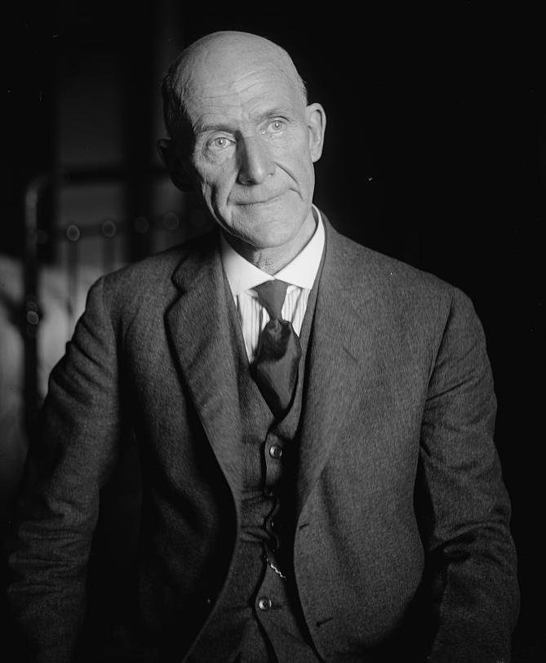
Legacy of the Case
In the years following Debs, federal courts issued thousands of strike-busting injunctions.
The use of injunctions was very controversial and critics complained of “government by injunction.”
Some historians argue the courts weakened the labor and socialist movements in the U.S.
In 1932, Congress passed a law prohibiting courts from issuing injunctions in labor cases.
Eugene V. Debs
Courtesy: Library of Congress

