Slide 1
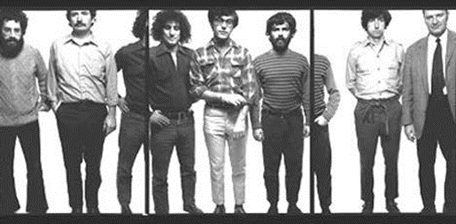
The Chicago Seven
Courtesy: Library of Congress
Federal Trials and Great Debates
in United States History

Slide 2
America in 1968
America was deeply divided in 1968.
Many (though not all) had become disillusioned with the Vietnam War.
Thousands staged occupations of universities and protested in the streets.
Martin Luther King, Jr. was assassinated in April, sparking race riots.
Further assassinations and political instability added to a growing sense of unrest.

Slide 3
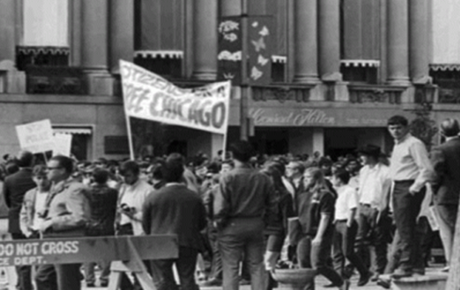
The Chicago DNC
Lyndon Johnson did not to seek re-election after a strong challenge from anti-war candidate Eugene McCarthy.
Robert F. Kennedy was murdered after winning the California primary.
Party leaders were unhappy with the idea of a “dove” candidate.
They favored V.P. Hubert Humphrey, who had not run in the primary but supported the war.
Protestors at the Chicago Convention
Courtesy: Chicago History Museum

Slide 4
The Chicago DNC
Chicago had been run by controversial mayor Richard Daley since 1955.
Daley had reacted harshly to previous protests and riots.
He put 12,000 police officers on 12-hour shifts and asked the governor to call out an additional 6,000 National Guard troops.
At least 10,000 protestors attended.
The eventual defendants represented virtually every faction involved in the protests.

Slide 5
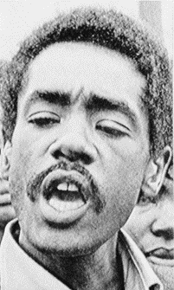
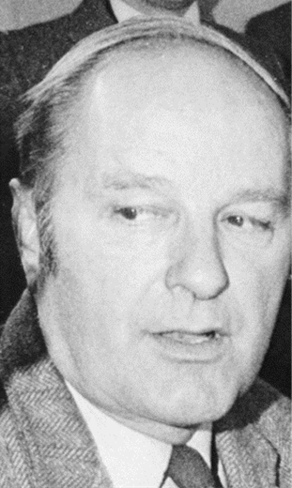
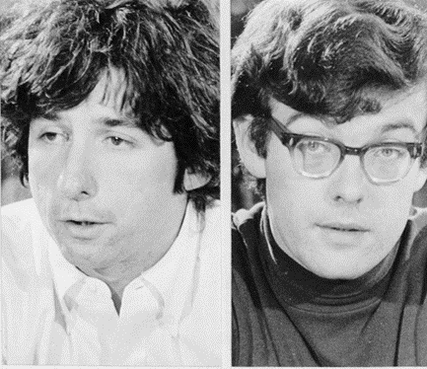
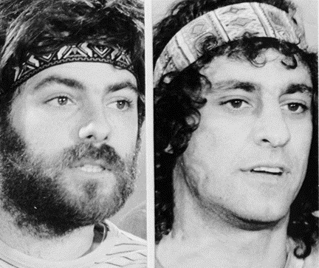
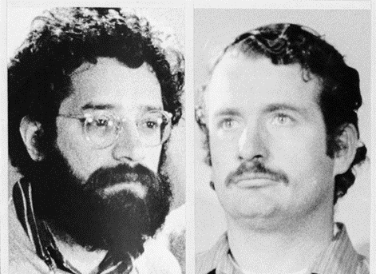
The Defendants
David Dellinger was a pacifist.
John Froines and Lee Weiner were radical scholars.
Tom Hayden and Rennard “Rennie” Davis had been involved in student politics before becoming activists.
Robert “Bobby” Seale was a leader of the Black Panthers, an African-American militant group.
Abbot “Abbie” Hoffman and Jerry Rubin were part of the “counter-culture.” They aimed to ridicule and undermine traditional authorities.
Lee Weiner John Froines
Courtesy: Bettman/Corbis
Jerry Rubin Abbie Hoffman
Courtesy: Bettman/Corbis
Tom Hayden Rennie Davis
Courtesy: Bettman/Corbis
David Dellinger
Courtesy: Bettman/Corbis
Bobby Seale
Courtesy: Bettman Corbis

Slide 6
Violence and Indictments
Throughout the convention, police and protestors clashed violently in the city’s parks and streets.
The violence climaxed on August 28th, the night Humphrey was to accept the party’s nomination.
Protestors attempted to march to the convention site down one of the city’s main roads.
Police lost control of the crowd and began beating protestors indiscriminately.
Approximately 600 protestors were arrested and 200 police and protestors were injured in the fighting.

Slide 7
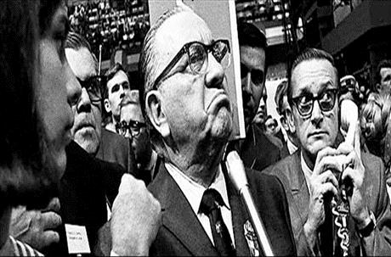
Violence and Indictments
A subsequent federal investigation described the event as a “police riot.”
Daley claimed the violence was caused by the protestors.
Republican Richard Nixon won the election in November, 1968 promising to restore “law and order.”
Eight protestors and eight police officers were indicted in March, 1969.
The officers were acquitted in a separate trial.
Mayor Daley on the convention floor
Courtesy: Associated Press

Slide 8
Judge Julius Hoffman
Had little tolerance for the defendants’ hijinks.
Often responded sarcastically to defense, prompting bias claims.
Many observers analogized the conflicts between the defendants and the judge to the counter culture vs. the mainstream.
Judge Julius Hoffman
Courtesy: Bettman/Corbis

Slide 9
Bobby Seale
Clashed with Judge Hoffman from the start.
The judge denied Seale his attorney of choice because he was unable to attend the start of trial.
Judge Hoffman also denied Seale’s repeated attempts to represent himself.
Seale reacted angrily to these rulings, calling Hoffman a “pig,” a “fascist,” and a “racist.”
Courtroom drawing of Seale gagged and bound in court
Courtesy: Library of Congress

Slide 10
Bobby Seale
After Seale ignored warnings, Judge Hoffman had Seale bound and gagged.
Although the judge had the power to take this step, it was very controversial.
When Seale continued to protest, Hoffman declared a mistrial and sentenced Seale to four years in prison for contempt of court.
Courtroom drawing of Seale gagged and bound in court
Courtesy: Library of Congress

Slide 11
Defendants’ Behavior
The remaining defendants became known as the “Chicago Seven.”
The trial was filled with interruptions, arguments, and theatrics for almost five months.
At times, as many as 19 marshals were brought into the courtroom to maintain order.
The defendants frequently refused to rise.
They munched on jelly beans, made requests to distribute birthday cake to the court, and attempted to read Vietnam casualty lists aloud.
When a defense witness was asked how hippies dressed, Abbie Hoffman lifted his shirt and danced around the courtroom, explaining that hippies were “naked.”

Slide 12
Defendants’ Behavior
Judge Hoffman jailed Dellinger for calling him biased and referring to a prosecutor as a “snake” and a “Nazi.”
Abbie Hoffman responded by telling the Judge he was “a disgrace to the Jews [and] would have served Hitler better.”
When the judge refused a motion to reinstate Dellinger’s bail, Hoffman and Rubin entered court wearing judicial robes marked with yellow stars of David.
Their idea was to ridicule and delegitimize traditional sources of authority like the courts.

Slide 13
Convictions and Sentences
While the jury deliberated, the judge cited the defendants and their lawyers for a combined 159 counts of contempt of court during the trial.
Some of the citations were for the defendants’ theatrics, some for repeated or disrespectful argumentation and others for seemingly minor slights like blowing kisses, laughing or refusing to stand.
The sentences ranged from less than three months for Weiner to more than four years for defense Attorney William Kunstler.

Slide 14
Convictions and Sentences
When the jury returned after five days of deliberation, it found all seven defendants not guilty of conspiracy and found Froines and Weiner not guilty on all charges.
It found the remaining defendants guilty of travelling between states to incite a riot.
Judge Hoffman imposed the maximum sentence of five years on all five convicted defendants.

Slide 15
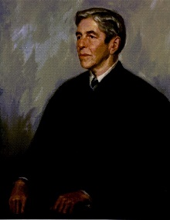
Appeals and Retrial
In 1972, the Court of Appeals for the Seventh Circuit overturned both the riot act and contempt convictions.
The government dropped the other charges but retried some of the contempt charges before Judge Edward Gignoux.
Judge Gignoux rejected most of the contempt charges.
He found Kunstler and several of the defendants guilty of the most serious contempt charges.
However, he refused to impose any prison time.
Both the 7th Circuit and Judge Gignoux criticized Judge Hoffman’s conduct of the trial.
Judge Edward Gignoux
Courtesy: Garbrecht Law Library, University of Maine School of Law

