Slide 1
Bush v. Orleans Parish
School Board
Courtesy: Norman Rockwell Museum, Stockbridge Massachusetts
Federal Trials and Great Debates
in United States History

Slide 2
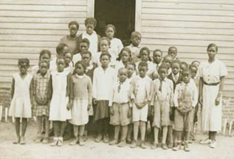
School Segregation
In the 1880s and 90s, southern states imposed the “Jim Crow” segregation system to reassert white dominance.
Some northern and “border” states also had forms of segregation.
In Plessy v. Ferguson (1896), the Supreme Court held segregated facilities were constitutional if they were “equal.”
A 1927 case applied the “separate-but-equal” doctrine to schools.
Students at a Maryland “colored” school (circa. 1935)
Courtesy: Library of Congress

Slide 3
School Segregation
Separate schools were seldom equal in practice.
African-American schools usually had inferior facilities and underpaid, overworked teachers.
Many observers claimed segregated education created a sense of “inferiority.”
In the mid-20th century, groups like the NAACP launched legal challenges to school segregation.
Students at a Maryland “colored” school (circa. 1935)
Courtesy: Library of Congress

Slide 4
The Suit Begins
In September 1952, Oliver Bush filed a lawsuit with 34 other plaintiffs to integrate New Orleans’ schools.
Bush was an African-American father of eight.
“Colored” schools in New Orleans received less money and were more crowded than “white” schools.
The case raised similar issues to a group of suits then before the Supreme Court of the United States.
The parties agreed to postpone proceedings to wait for the Supreme Court’s ruling.
A.P. Tureaud, lead lawyer for much of the Bush litigation
Courtesy: Amistad Research Center
at Tulane University

Slide 5
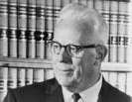
Brown v. Board of Education (1954 & 1955)
School desegregation cases from four states were consolidated as Brown v. Board of Education in the Supreme Court.
In 1954, the Court unanimously ruled that segregated schools violated the Constitution’s Equal Protection Clause.
In a second opinion in 1955, the Court ordered that school districts must desegregate with “all deliberate speed.”
This ambiguous phrase left many of the details of desegregation to lower courts.
Chief Justice Earl Warren wrote the Court’s opinions in Brown
Courtesy: Library of Congress

Slide 6
U.S. District Courts
Since 1912, U.S. district courts have been the primary trial courts in the federal system.
Most trials in district courts are conducted by a single judge.
At the time Bush was decided, a three-judge panel was required where a case challenged the constitutionality of a state law.
Supreme
Court
of the U.S.
U.S. Courts of Appeals
U.S. District Courts

Slide 7
U.S. District Courts
The district court would have to implement the “all deliberate speed” standard in Bush using its equity powers.
Equity is a branch of the law that allows judges to craft specific orders that take account of the special facts in each case.
This meant ensuring local authorities did not engage in needless delays.
It also meant the court had to take local conditions and the difficulties desegregation posed for the school district into account.
Supreme
Court
of the U.S.
U.S. Courts of Appeals
U.S. District Courts

Slide 8
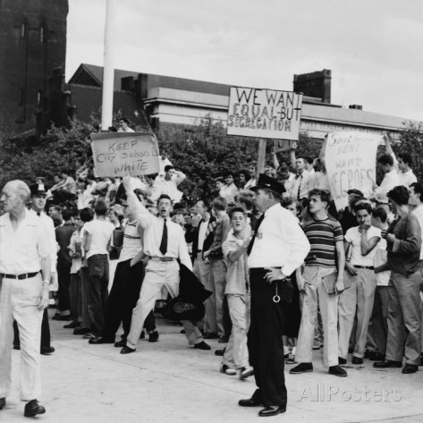
Massive Resistance
The Brown decisions were unpopular with many southern whites.
They argued the Court had overstepped its constitutional authority.
Many southern politicians promised a wave of “massive resistance” to desegregation.
In 1954, Louisiana amended its constitution to require segregated schools.
The amendment attempted to avoid Brown by claiming it was designed to aid the health, safety, and general welfare of the state and was “not because of race.”
Anti-integration protests in Baltimore (1955)
Courtesy: Library of Congress

Slide 9
Initial Rulings
Bush recommenced shortly after the second Brown ruling.
In 1956, a three-judge panel of the U.S. District Court for the Eastern District of Louisiana held that New Orleans’ segregated school system violated the Constitution.
The panel also invalidated the Louisiana constitutional amendment.
The same day, Judge J. Skelly Wright issued an order requiring New Orleans to desegregate its schools with “all deliberate speed.”
Circuit Judge Wayne Borah,
a member of the three-judge panel
Courtesy: Library of Congress

Slide 10
Judge Wright
Judge Wright presided over most phases of the complex litigation process in Bush.
Wright believed he was obligated to implement the Supreme Court’s ruling in Brown despite local opposition.
He was a native of New Orleans, but his rulings made him deeply unpopular with many whites in the area.
Wright received frequent hate mail and threats from critics who argued he was undermining democracy and the Southern “way of life.”
Judge J. Skelly Wright
Courtesy: Library of Congress

Slide 11
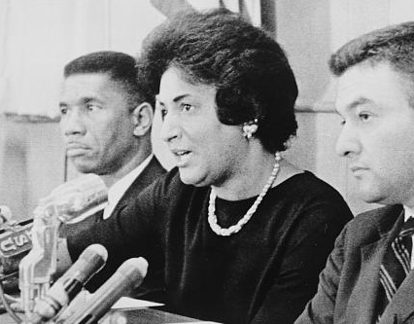
Louisiana’s Response
In 1956, the state amended its constitution to bar all lawsuits against school boards.
Judge Wright declared the amendment unconstitutional.
In 1958, the legislature passed laws that empowered the governor to close any “racially mixed schools[.]”
Another new state law stated no child could be forced to attend a racially “commingled school” and offered grants for private segregated schools.
In 1959, lawyers for Bush and the NAACP returned to Judge Wright’s court to demand an end to the delays and defiance of his orders.
Future federal judge Constance Baker Motley (center) was one of several NAACP lawyers in the case
Courtesy: Library of Congress

Slide 12
Desegregation Plans
Judge Wright ordered the city to develop a desegregation plan by May, 1960.
Officials refused to comply with the order, arguing state law required segregation.
Judge Wright initiated his own plan for desegregation, ordering phased integration beginning with the first grade.
The school board then proposed an alternative plan that required black students wishing to attend “white” schools to request a transfer.
After testing the 137 black applicants for transfer, the board allowed only 5 (eventually 4) students to do so.
Judge J. Skelly Wright
Courtesy: Library of Congress

Slide 13
Continued Resistance
Despite the very limited plans for desegregation, Louisiana’s politicians remained defiant.
The legislature passed an “interposition” law that claimed the power to nullify unconstitutional acts of the federal government.
It imposed a mandatory jail sentence on federal judges or officials who attempted to desegregate schools.
It also assumed control of the city’s schools.
Judge Wright again blocked enforcement of the new statutes.
The New Orleans desegregation crisis inspired Norman Rockwell’s
“The Problem We All Live With”
Courtesy: Norman Rockwell Museum, Stockbridge Massachusetts

Slide 14
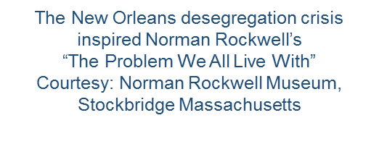
Continued Resistance
The school superintendent then declared a “holiday” for the first day of desegregation.
Judge Wright threatened to hold the superintendent in contempt of court.
The legislature then:
  Fired the superintendent and the schoolboard lawyer;
  Seized control of the city’s schools;
  Again declared a school holiday; and
  Authorized sergeants-at-arms to keep the schools closed.
Judge Wright issued an injunction against hundreds of state officials ordering them not interfere with desegregation.
Federal marshals prepared to escort the students to school.

Slide 15
Desegregation
On November 14th, 1960, four African-American girls attended formerly all-white schools in New Orleans.
Almost all white parents removed their children from school and thousands protested, yelling abuse at the girls.
The families of white students who attended integrated classes faced death threats.
The state legislature attempted to continue its defiance, denying funds to the school board.
Nevertheless, desegregation expanded the following year as resistance began to wane.
Ruby Bridges, one of the first students to attend integrated classes
Courtesy: Library of Congress

Slide 16
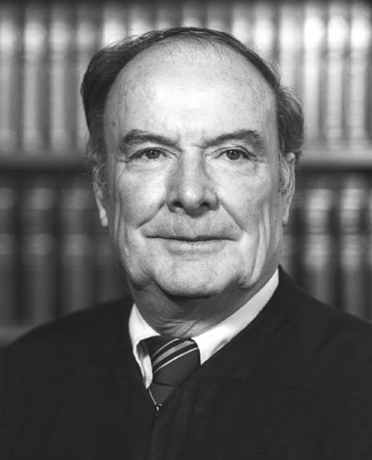
Aftermath and Legacy
In April, 1962, Judge Wright ordered the desegregation of grades one through six.
Shortly after this order, Wright was appointed to the U.S. Court of Appeals for the District of Columbia Circuit.
His successor, Judge Frank Ellis, adopted a slower approach, but desegregation efforts continued.
Judge Wright on the U.S. Court of Appeals for the D.C. Circuit
Courtesy: Library of Congress

Slide 17
Aftermath and Legacy
Scholars debate the success of school desegregation in areas like New Orleans.
Through the actions of civil rights lawyers and judges like Judge Wright, legal segregation was abolished.
However, many students continue to attend schools with little racial diversity because of other factors.
For instance, the process of “white flight,” whereby many white families left inner cities for suburbs, beginning in the 1950s and 60s, made geographically-assigned schools less diverse.
Moreover, the widespread use of property taxes to pay for local schools has exacerbated the economic divide between “white” and” non-white” schools in some areas.
Judge Wright on the U.S. Court of Appeals for the D.C. Circuit
Courtesy: Library of Congress

