Slide 1

Introduction to Bankruptcy Law and the Bankruptcy System:
An Educational Primer for State Courts
[Template Presentation For Educational Use]
This template presentation, provided by
the Federal Judicial Center, combines, edits, and expands presentations given by bankruptcy judges and state trial court judges. Contact Jason A. Cantone, at fedstate@fjc.gov, for more information.
Notes:
This presentation was greatly benefitted by the following individuals, who reviewed an earlier draft of the presentation: Hon. Shon Hastings, Hon. Craig Whitley, Hon. Cate Furay, Hon. Charles L. Nail, Jr., Hon. Ashely Chan, Hon. Robert Kressel, Hon. Robert Drain, Hon. Diane Finkle, Hon. Robert Faris, Elizabeth Wiggins, and Brian Lynch. The presentation utilizes and expands on prior educational materials provided alongside interviews held by Dr. Jason Cantone with: Hon. Dan Collins, Hon. Brian Davis, Hon. Robert Faris, Hon. Cate Furay, Hon. Martin Glenn, Hon. A. Benjamin Goldgar, Hon. Mary Gorman, Hon. Laurel Isicoff, Hon. Catherine McEwen, Hon. Robyn Moberly, Hon. Mindy Mora, Hon. Chris Panos, Hon. Laura Taylor, and Ann M. Anderson. This presentation was made better by all of these individuals, as well as the Judicial Conference Committee on Federal-State Jurisdiction.

Slide 2


Content Note
This presentation only provides the bankruptcy overview. A full presentation with all six topics (bankruptcy overview; automatic stay; bankruptcy discharge; family law; foreclosure; additional considerations) is available at fjc.gov/fedstate, as well as separate presentations for each of those topics.
Notes:
If you would like a Powerpoint that includes the full presentation or the topics provided in the note, please visit fjc.gov/fedstate.

Slide 3
Overview of Bankruptcy

Slide 4
Someone tells you they filed bankruptcy.
What could a state court judge do?
Ask
Ask for the bankruptcy case number and where the debtor filed it.
Consider
Consider whether the state proceeding would violate the stay.
Continue
If you think the stay applies, continue the proceeding until you have confirmation there is relief from the stay or the stay was dissolved.
Call
Call the bankruptcy clerk’s office to ask whether the debtor filed a petition and whether relief from the automatic stay was granted.
Call
Call a bankruptcy judge (or his/her law clerk) – Many bankruptcy judges would welcome calls from state court judges!

Slide 5

The “Twin Pillars” of Bankruptcy
equality of distribution of available assets among similarly situated creditors
fresh start for honest but unfortunate debtors

Slide 6
Bankruptcy Policies
Equality of distribution
  Priority given to creditors holding certain types of debt.
  Pro rata distribution for similarly situated creditors preventing a race to the courthouse.
  Important factors: context of reorganization, adjustment of debt and repayment plan, and liquidation.
Fresh start
  Automatic stay freezes collection activity to give debtor a “breathing spell.”
  Discharge releases debtor from personal liability for certain specified types of debt; a permanent injunction on collection.
  Federal and state laws allow debtors to keep certain assets (exempt property).

Slide 7

Bankruptcy Policies
Maximizing value of assets and distributions
Obtain best possible price for assets, financing, and new equity to maximize recovery for creditors.
Reorganizing and rehabilitating businesses can preserve jobs.

Slide 8
Who are the parties?
Debtor: Individual or organization that has voluntarily filed a bankruptcy petition or, in rare cases, is the subject of an involuntary bankruptcy commenced by creditors.
Debtor-in-possession: Debtor in a case that maintains possession and control of its assets (i.e., existing management remains in place) in bankruptcy.
Creditors: Individuals or organizations to which the debtor owes money or that claim to be owed money by the debtor.
Trustee: Representative of the bankruptcy estate who exercises statutory powers, principally for the benefit of unsecured creditors.
Trustee is always appointed or elected in Chapters 7, 12, 13; sometimes in Chapter 11; never in Chapter 9.

Slide 9



Who are the parties?
U.S. Trustee: Officer of the Department of Justice responsible for supervising administration of bankruptcy cases
A “watch dog” over the bankruptcy process; different from “trustee”
Examiner: Independent functionary appointed to conduct an investigation of the debtor’s affairs in a Chapter 11 case in which existing management remains in place and no case trustee is appointed
Bankruptcy Administrator: Oversees the administration of bankruptcy cases, maintains a panel of private trustees, and monitors the transactions and conduct of parties (North Carolina and Alabama, Established in 1986)

Slide 10
Who are the parties?
Creditors’ Committee: A committee of creditors appointed by the U.S. Trustee in Chapter 11 cases and ordinarily consisting of unsecured creditors holding the largest unsecured claims against the debtor; consults with “debtor-in-possession” on administration of the case; investigates the debtor’s conduct and operation of the business; participates in formulating a plan of reorganization.
Creditors’ committees may also be formed for other claimant groups such as secured creditors, bondholders, and retirees.
Notes:
Regarding a Chapter 11 creditor’s committee and acceptance of plan, they do not apply in subchapter V (SBRA) cases under Chapter 11.

Slide 11
Bankruptcy Law 101: Chapters
 | Debtor(s) | Description
7 | Business or Individual | Provides for “liquidation” or sale of the debtor’s nonexempt property and the distribution of proceeds to creditors. Liquidation is administered by a trustee.
9 | Municipality | Provides for the restructuring of a municipality’s debts.
11 | Business or individual | Provides for “reorganization,” usually of a corporation or partnership; a Chapter 11 debtor usually proposes a plan of reorganization to keep its business alive and to pay creditors over time; people in business and individuals can also seek relief under Chapter 11. Court holds a confirmation hearing and at least one class of impaired creditors must support the plan.
12 | Business or individual | Provides for adjustment of debts of a “family farmer” or “family fisherman.”
13 | Individual | Provides for adjustment of debts of an individual with regular income; a Chapter 13 debtor is usually allowed to keep property and pay debts over time.
15 | Business (outside of U.S.) | Provides for cooperation in ancillary and other cross-border cases.

Slide 12
Questions to consider
Is the bankruptcy a Chapter 7, 11, 12, or 13?
Who is the actual debtor in the bankruptcy? (Individual, married couple, other?)
Who is the proper party to a lawsuit in which the debtor is a party? (Chapter 7 trustee, debtor-in-possession under Sections 323, 1303, 1203, or 1107, emerging debtor, court-appointed trustee?)
  Is substitution necessary? (Typically, only in a Chapter 7 case.)
Is the debt a Domestic Support Obligation (DSO)?

Slide 13
Questions to consider
Does the automatic stay apply?
If so, has the court granted relief from the stay?
Has the exempt property been determined?
Is the debt dischargeable or has the debt been discharged?
Have any payments been made to the Chapter 13 trustee on account of past-due support obligations?

Slide 14
The Chapter 9 Process
Chapter 9 bankruptcy will not be discussed in this presentation.
For more information on Chapter 9, see:
Navigating Chapter 9 of the Bankruptcy Code
(a 2017 publication coordinated by the Federal Judicial Center (FJC))
Chapter 9 Online Resource Repository
(an FJC resource with examples of case documents and other resource materials related to issues likely to arise in Chapter 9 cases)
Notes:
https://www.fjc.gov/content/326128/navigating-chapter-9-bankruptcy-code

Slide 15
The Chapter 7 Process
Petition, schedules, and statement
of financial affairs filed
inception of automatic stay
creation of the “estate”
appointment of trustee
notice to creditors of case commencement, meeting of creditors, and discharge and claims objections
Meeting of creditors (“341 meeting”)
Issuance of Discharge
Liquidation of Nonexempt Assets, if any (prevalence of “no asset” cases)
Closing of case
Note: The majority of cases are over in about 120 days

Slide 16
Chapter 11, Subchapter V
As a result of passage of the Small Business Reorganization Act (which went into effect February 19, 2020), there is a new Subchapter V to Chapter 11, with a number of unique provisions for small business debtors.
Advice: For those involved in cases with small business debtors, reviewing this new subchapter is important.

Slide 17
Chapter 13
Process
Chapter 13 is another means for individual debtors to get a discharge of their debts.
Requires a debtor to formulate a repayment plan and to schedule payments to creditors of their disposable income over a
three-to-five-year period.

Slide 18
Chapter 13
Process
Once the Chapter 13 plan is finalized and negotiated with the debtor’s creditors and the Chapter 13 trustee, the court will enter a confirmation order approving the plan.
Only when the Chapter 13 debtor finishes making all of the payments due under the plan does the debtor get an order of discharge.

Slide 19
Chapter 13
Process
Caution: Chapter 13 changes the definition of “property of the estate” to include property acquired postpetition.
See 11 U.S.C.§1306(a)(1).

Slide 20
Chapter 13 Process
Petition, schedules, and statement of financial affairs filed
inception of automatic stay
creation of the “estate,” but debtor remains in possession
appointment of trustee
Filing of plan
Meeting of creditors (“341 meeting”)
Plan confirmation and performance over up to five years (trustee’s role)
Discharge issued when plan payments are complete
notice to creditors of case commencement, meeting of creditors, and discharge and claims objections

Slide 21
Why file under Chapter 13?
Means test and “abuse” standards compel some debtors to file under Chapter 13 (rather than Chapter 7)
Chapter 13 debtors can cure defaulted secured debts over plan term
Chapter 13 debtors can pay delinquent taxes over five years with no postpetition interest
Chapter 13 debtors get a slightly broader discharge

Slide 22
Property of the Estate
All legal and equitable interests of the debtor in property as of the date of the bankruptcy commencement.
  Includes legal claims by the debtor (including tort claims and lawsuits) against others, even if disputed or unliquidated.
  Does not include:
    property in which the debtor holds only legal title but no equitable interest
    beneficial interests in spendthrift trusts
    funds held in certain retirement and education savings accounts

Slide 23
Property of the Estate
The Bankruptcy Court has exclusive jurisdiction over property of the estate.
Individual debtors can exempt certain property from the estate, making it unreachable by unsecured creditors.

Slide 24
Property of the Estate
Income from personal services rendered after petition date:
  not included in Chapter 7 estate
  included in Chapters 11, 12, and 13 estates
Property leaves the estate by:
  sale (or other disposition) by trustee or debtor
  timely and valid claim of exemption by debtor
  abandonment (if the trustee decides the value is not worth administering in bankruptcy)

Slide 25
Removal and Remand
Civil actions related to a bankruptcy case may be removed to federal court on the basis of bankruptcy jurisdiction.
Removal is automatic upon the filing of a notice of removal with the appropriate court clerk.
The bankruptcy court may remand an action back to court from which it was removed upon the filing of a timely motion and on any equitable ground.
An order granting or denying remand is not subject to appellate review.

Slide 26
Removal and Remand
Advice:
When considering removal, remand, or bankruptcy court abstention in favor of a pending state court action, the bankruptcy court considers the status and projected date-to-outcome of a pending state court action if it were to continue in the state court.

Slide 27
The Rooker⎼
Feldman Doctrine
Lower federal courts, including the bankruptcy courts, may not review the decisions of state courts.
Where bankruptcy and state courts have concurrent jurisdiction, the Rooker–Feldman doctrine prevents a collateral attack upon a state court’s decision concerning federal law even when that decision is clearly erroneous.
Such a decision may be reviewed only through the appellate process.

Slide 28
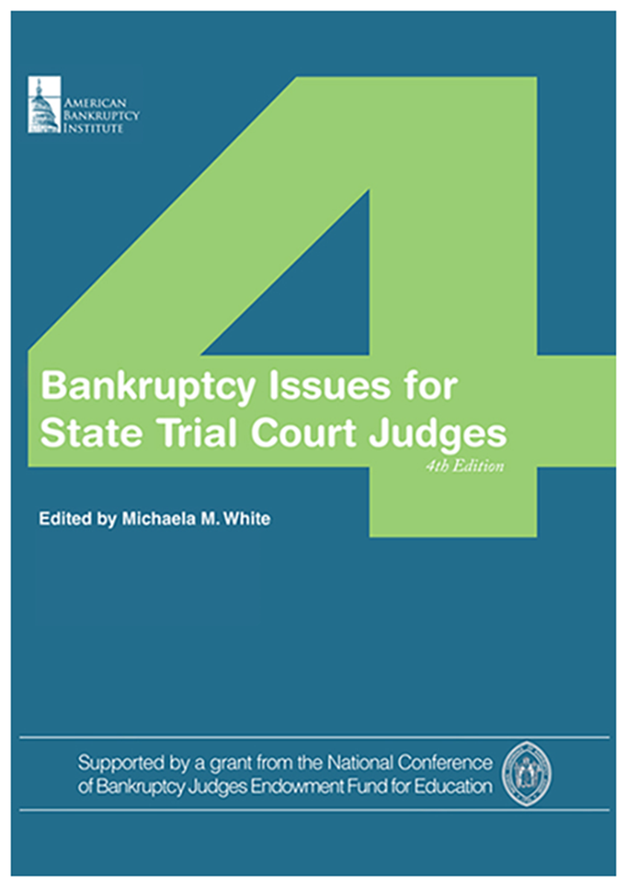
Additional
Resources
Federal Judicial Center website on federal-state cooperation: https://fjc.gov/fedstate
National Center for State Courts resource guide on foreclosures: https://www.ncsc.org/Topics/Financial/Foreclosures/Resource-Guide.aspx

Slide 29
Thank You
This presentation was organized
by Federal Judicial Center Senior Research Associate Jason A. Cantone, with considerable assistance by a number of federal and state judges and court personnel (see note for slide 1).
Questions about the presentation and its use can be directed to
Dr. Cantone, at fedstate@fjc.gov. We would also like to hear from you if you find it helpful or have any recommendations to improve it.

